Slide 1
NFIP Overview Briefing for the Subcommittee on Disaster Reduction
David Maurstad, Assistant Administrator for Federal Insurance
February 1, 2018

Slide 2
Flood Insurance vs. Individual Assistance
Flood Insurance
Available only to those who pay for coverage
Does not require Presidential disaster declaration (2 or more acres or properties normally dry now wet)
Coverage limits depend on purchase (up to $250,000 building, $100,000 contents)
Renters policy available
Flood only
No payback requirement
Continuous coverage, not cancelled after multiple claims
Disaster Assistance
Requires Presidential disaster declaration
May include grants for temporary housing, rental assistance, limited home repairs, and for other serious disaster-related needs
Repairs home to a habitable condition if no other assistance available
Maximum is $33,300 (FY 2017), average is $4,000 to $6,000
Most disaster assistance comes in form of disaster loans from Small Business Administration

Slide 3
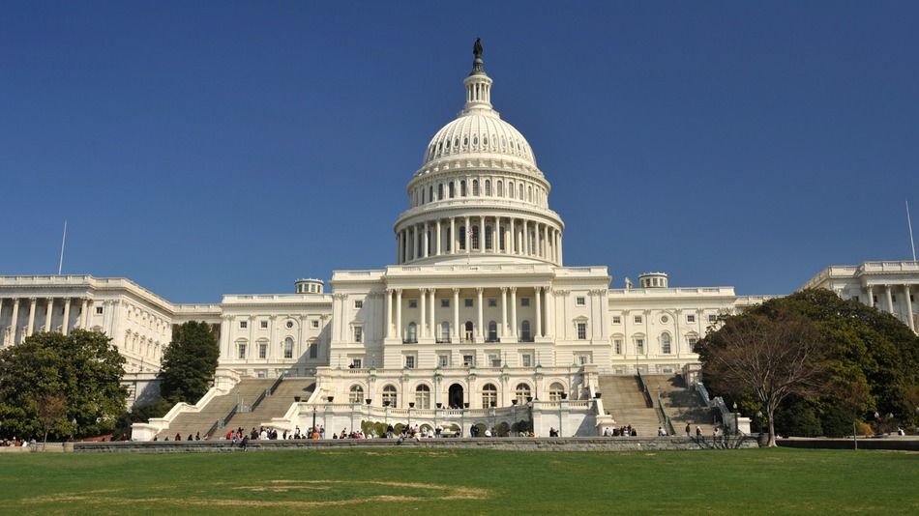
National Flood Insurance Program (NFIP)
Created by Congress in 1968 as a way of reducing the financial and human toll of flooding disasters on the nation.
Mission of the NFIP
To educate American property owners about the risk of flood
To provide flood insurance, generally unavailable and unaffordable in the private insurance market
To accelerate recovery from flood damage
To mitigate future flood losses through local floodplain regulation
To reduce the personal and national costs of disaster
To promote the natural and beneficial functions of the floodplain
National Flood Insurance Act of 1968
https://www.fema.gov/media-library-data/20130726-1545-20490-9247/frm_acts.pdf

Slide 4
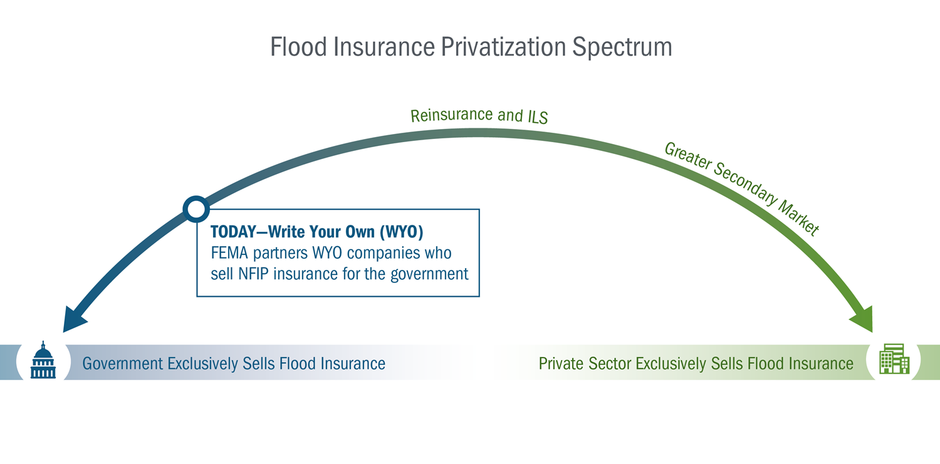
How the NFIP Operates
Congress authorizes NFIP to operate, sets strategic priorities, represents constituents to FEMA
FEMA sets actuarial rates, policies, underwriting and claims criteria, specific coverage costs, manages oversight or partners and vendors, oversees financials, markets, educates public, trains agents and adjusters, etc.
WYO companies manage day-to-day sales and servicing of policies including claims, through their networks of agents and claims adjusters
Direct Servicing Agent is a FEMA-contracted entity which acts similarly to a WYO for independent agents or agents not affiliated with WYO companies.
Vendors service NFIP policies for many WYO companies and frequently manage operations on their behalf.

Slide 5
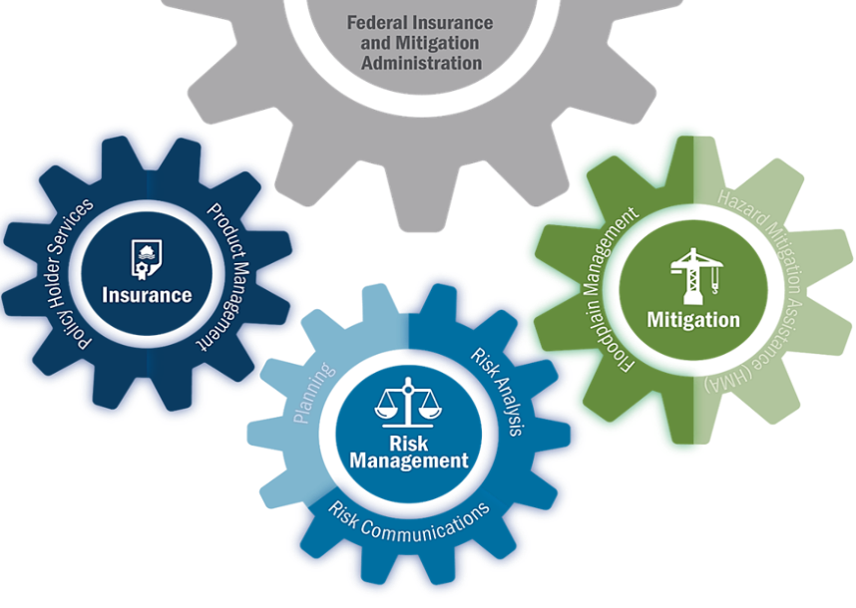
Elements of the NFIP
Mitigate Risk
Flood Mitigation Assistance (FMA) provides funding to states, territories, federally-recognized tribes, and local communities
FMA funds projects and planning that reduce or eliminate long-term risk of flood damage to structures insured under NFIP
Identify Risk
FEMA identifies flood hazards through scientific and engineering methods
FEMA maps hazards on Flood Insurance Rate Maps or FIRMs
FIRMs used for floodplain management, flood insurance, and risk communication
Insure Flood Risk
For homeowners, renters, and business owners with eligible structures in participating communities
~80 private insurance companies write NFIP coverage under their own names
FEMA underwrites all NFIP policies, and also writes some through NFIP Direct

Slide 6
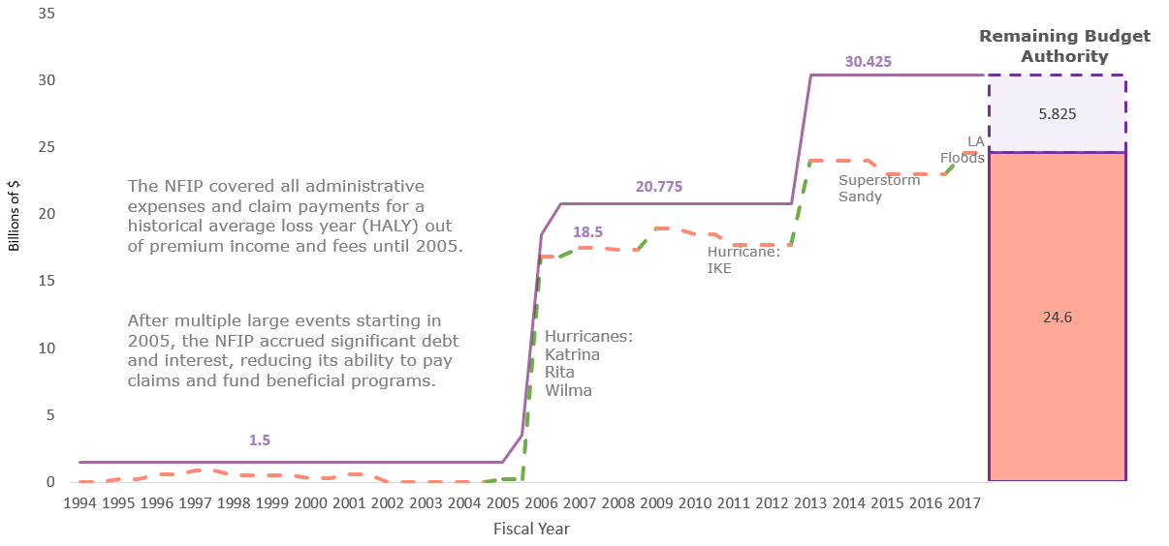
Achieving a Sound Financial Framework for the NFIP
Challenges:
Magnitude, volatility of flood losses (realized & potential)
Public policy choices yield benefits … but limit ability to grow financial reserves
Status Quo:
Basic financial structure
Significant unmanaged exposure
Sound Financial Framework:
Understand exposure
Use additional tools, including reinsurance
Clarity on who pays what when
The NFIP’s cumulative debt to Congress increased substantially from 2005-2016 due to extraordinary loss years where claims payouts exceeded premiums collected, and coincided with increases in borrowing authority.
In 2008, interest payments on debt associated with Hurricanes Katrina, Rita, and Wilma reached $730M.

Slide 7
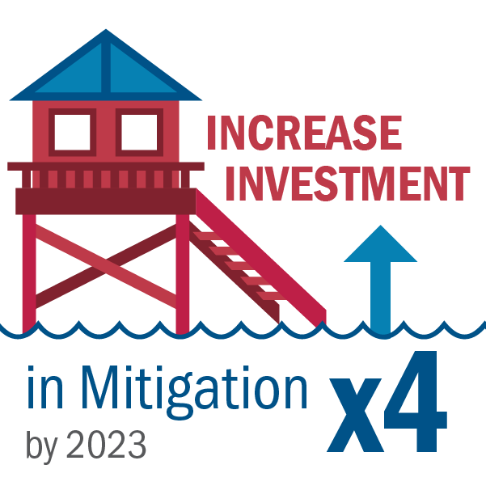
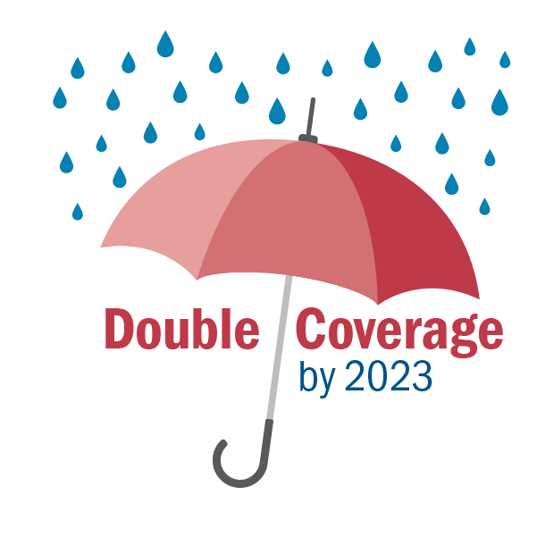

Slide 8
Reauthorization 2018
Working closely with our partners including Congress
NFIP Reauthorization principles include:
Timely, multi-year reauthorization
A sound financial framework
Increased flood coverage
Improved customer experience
Congress must continue to examine
difficult public policy issues:
Affordability
Privatization
Solvency and sound financials
February 8, 2018

Slide 9
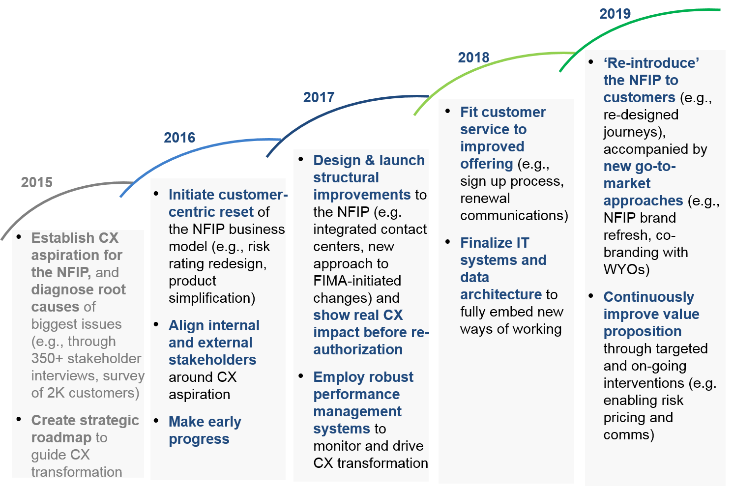
FEMA embarked on a multi-year effort to transform how our customers experience the NFIP

Slide 10
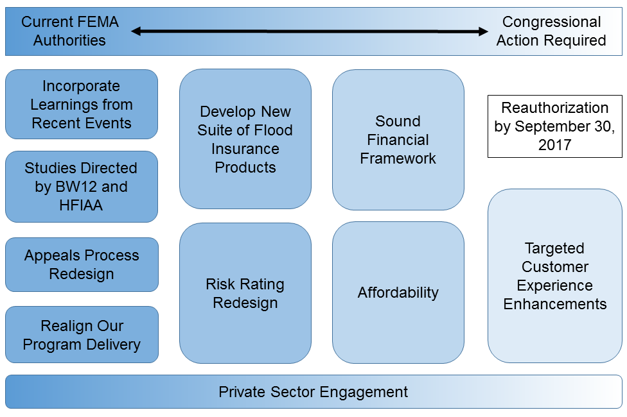
There are several ongoing efforts to transform the NFIP
Reauthorization Deadline:
February 8, 2018

