Slide 1

Subcommittee on Disaster Reduction
White House Conference Center
3 May 2018
Natural Hazards Mission Area
Dave Applegate; Deputy Director (Acting)
Ken Hudnut; Science Advisor for Risk Reduction
Dale Cox; Project Manager, Science Application
for Risk Reduction (SAFRR)
with Anne Wein, Sue Perry, Drew LaPointe, Keith Porter, Laurie Johnson, Jenn Strauss, Grace Kang, Arrietta Chakos, Kara Gross … and 60+ ‘HayWired Coalition’ collaborating organizations
Together… we can Outsmart Disaster

Slide 2

Dale Cox
Project Manager
U.S. Geological Survey
Science Application for Risk Reduction
Notes:
embed movie and set it up to auto-start

Slide 3
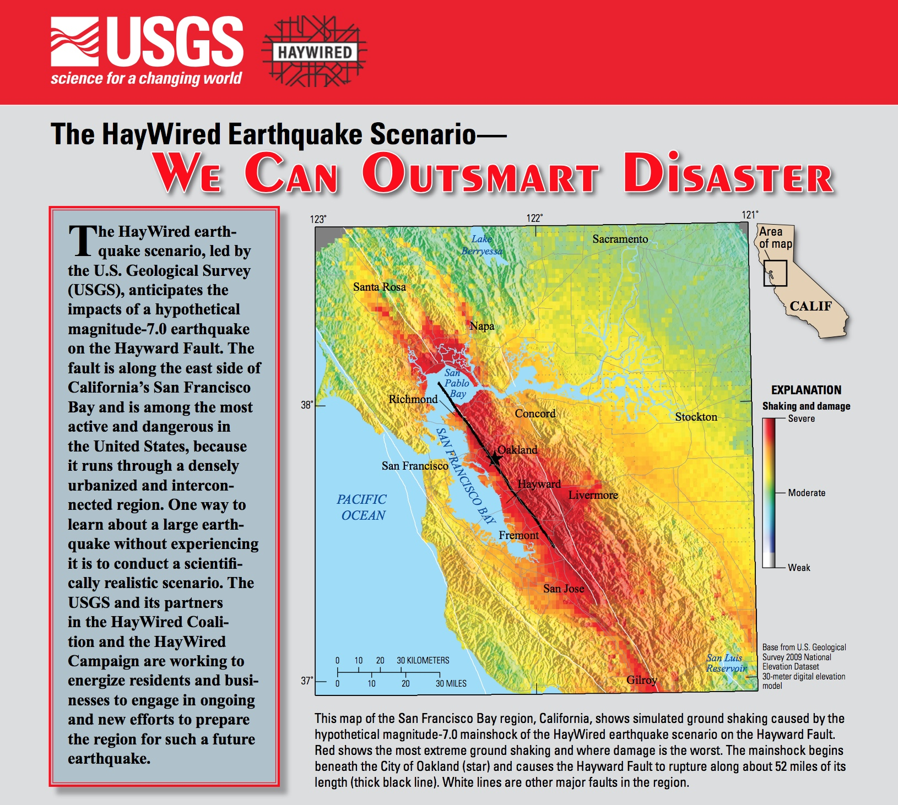
USGS Fact Sheet – The HayWired Earthquake Scenario
usgs.gov/HayWired
OutsmartDisaster.com
@HayWiredCA
#HayWired
#OutsmartDisaster

Slide 4
HayWired Movie (YouTube)
https://youtu.be/aRLb3PmIYFc

Slide 5
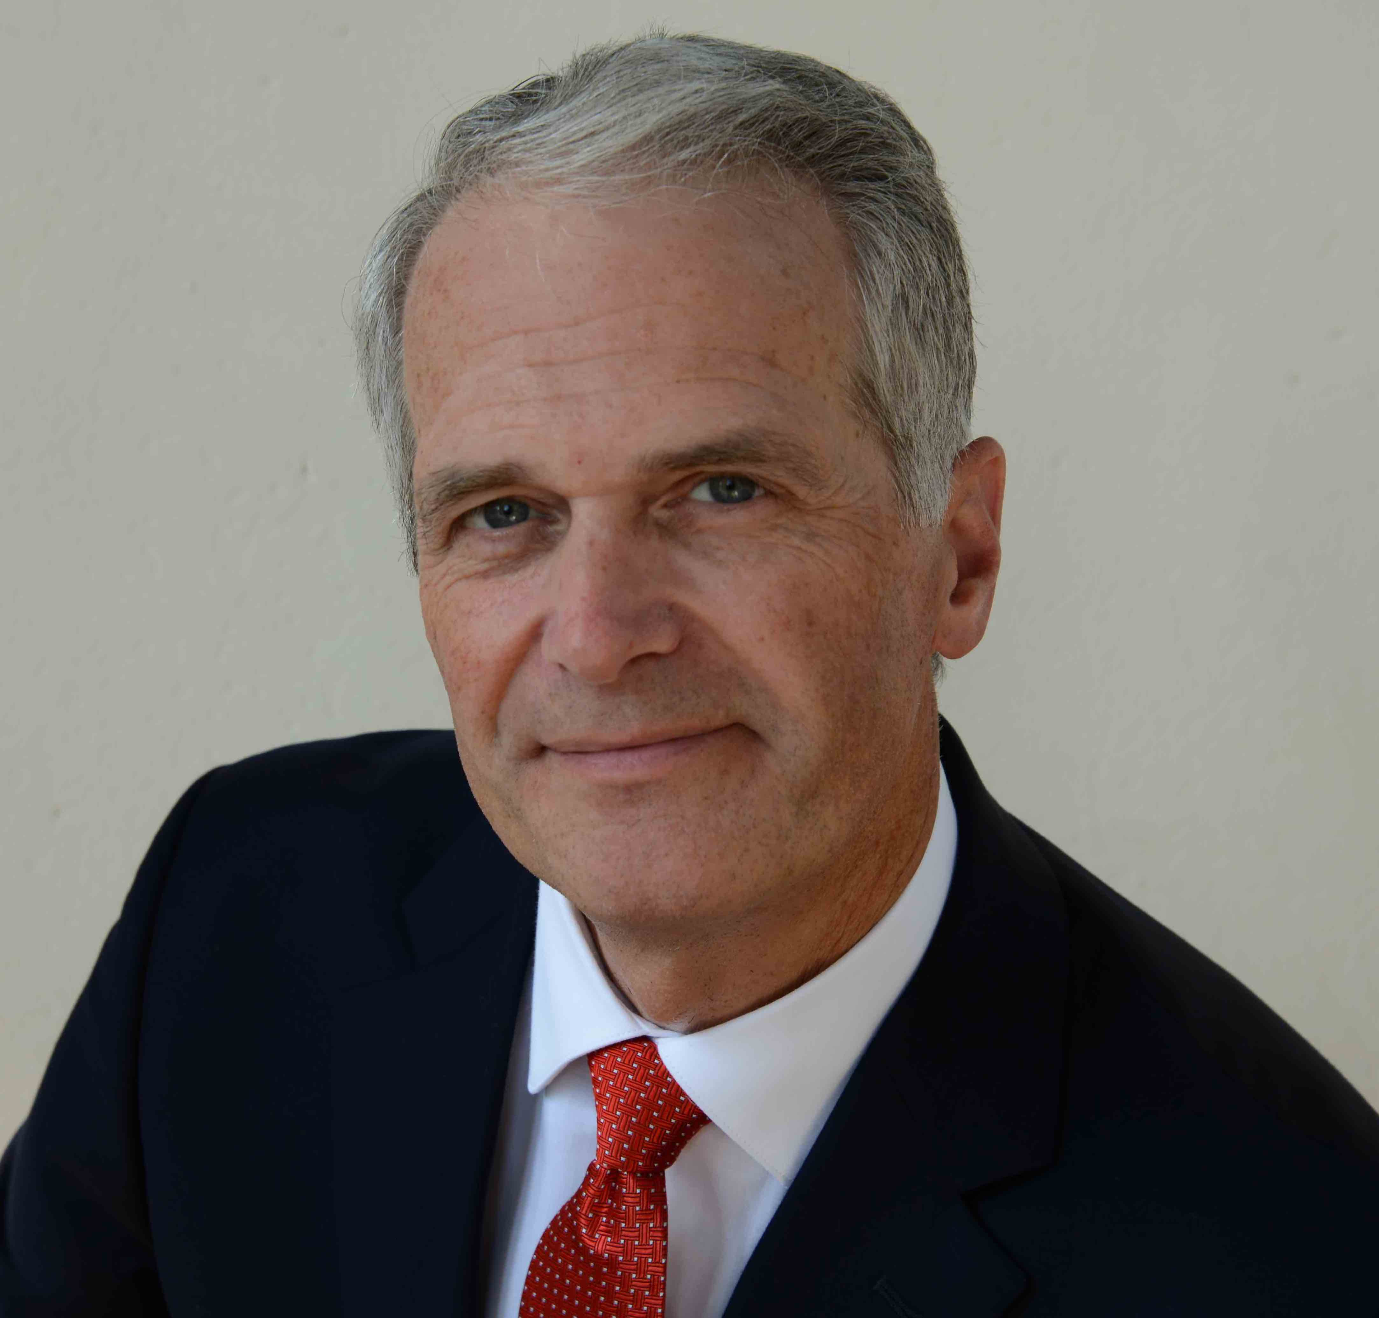
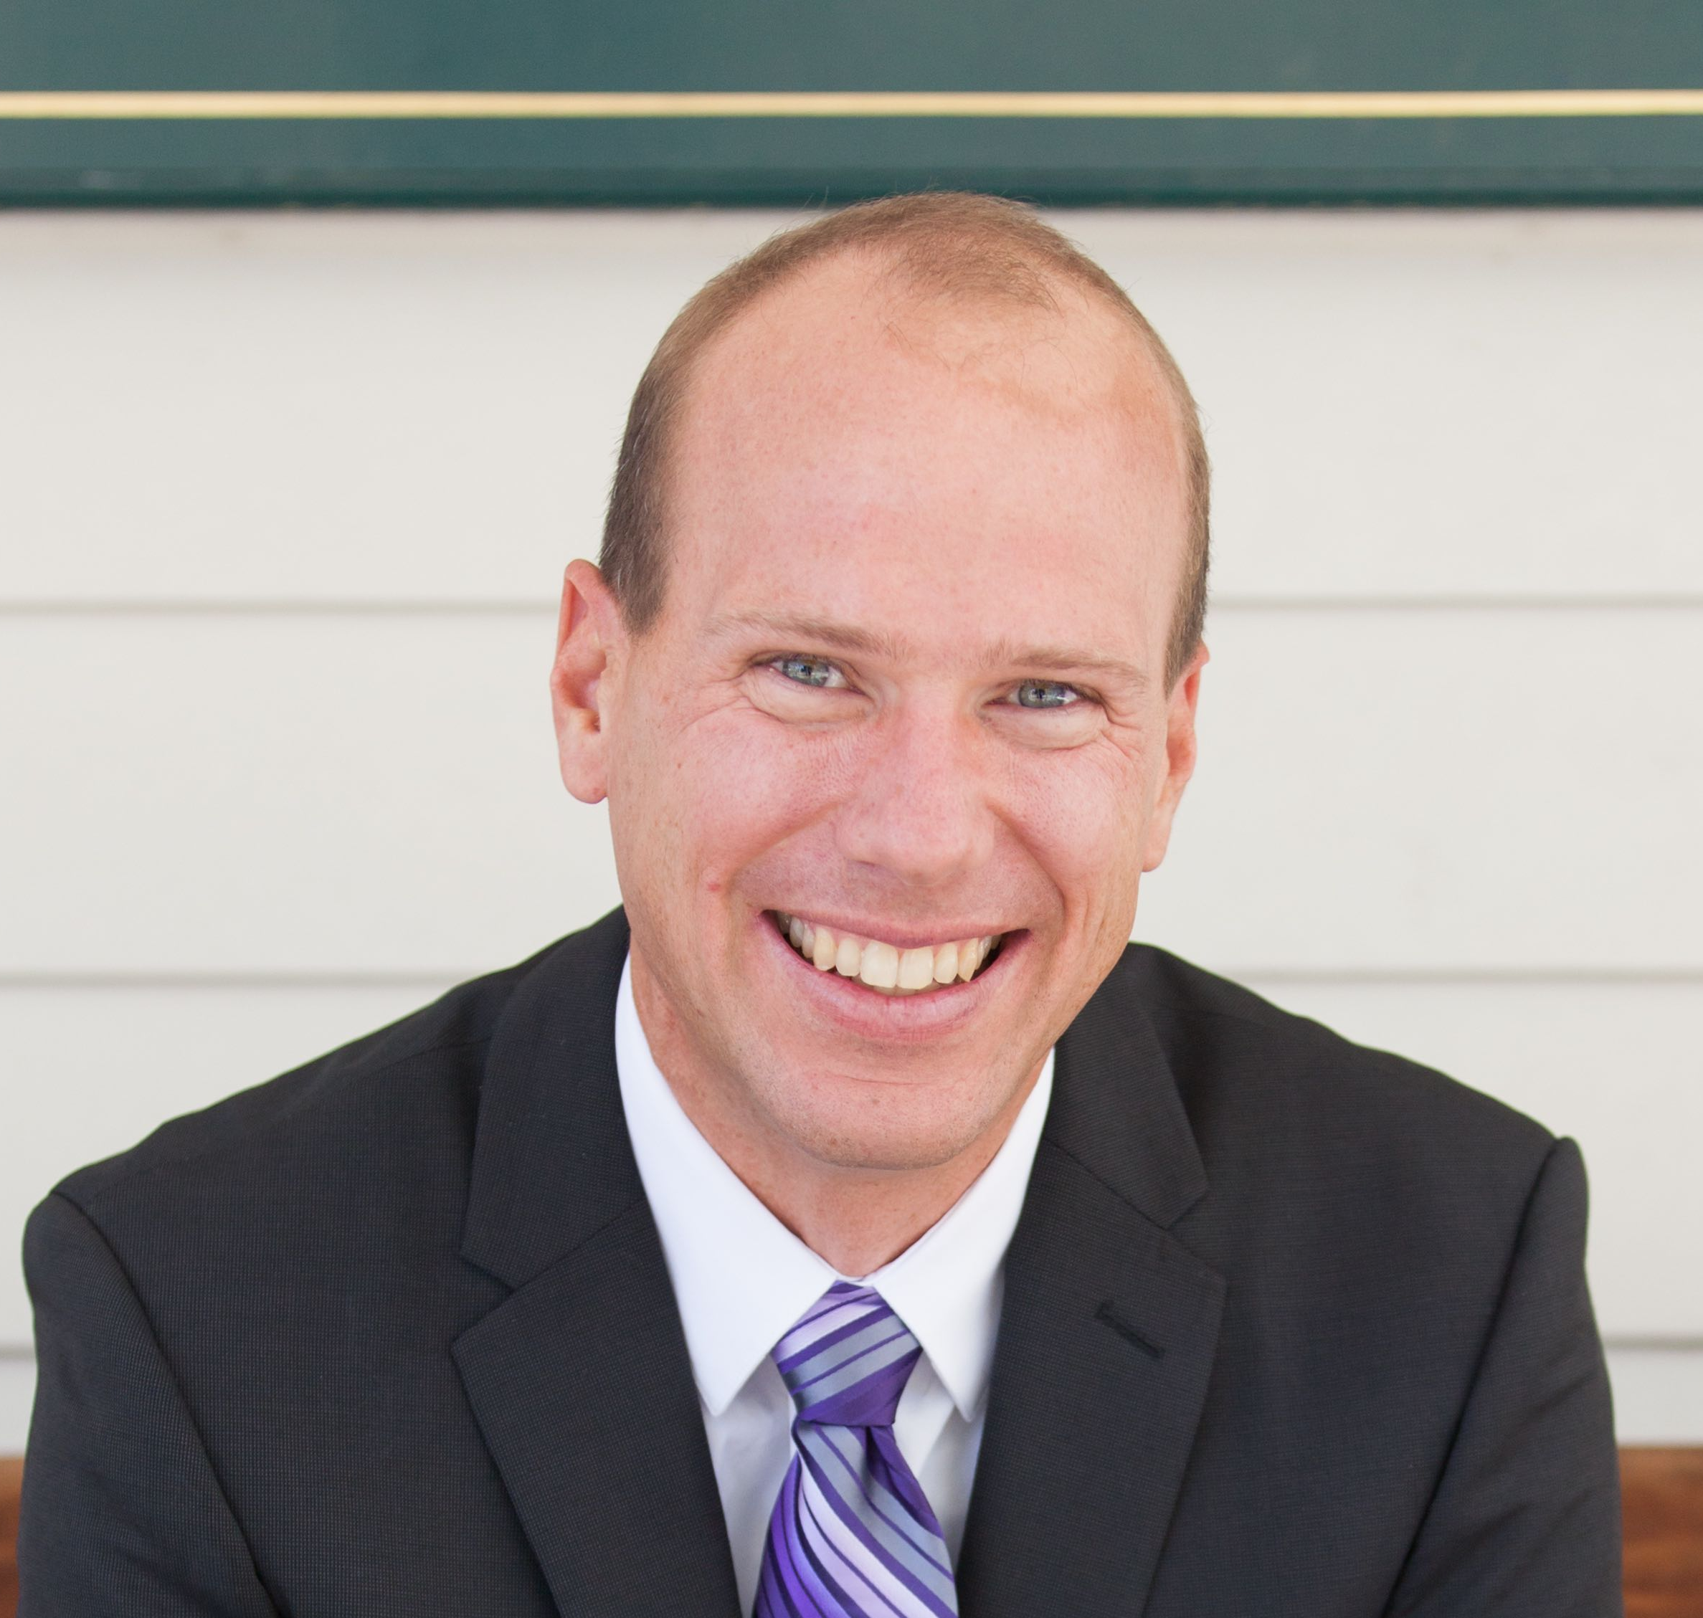
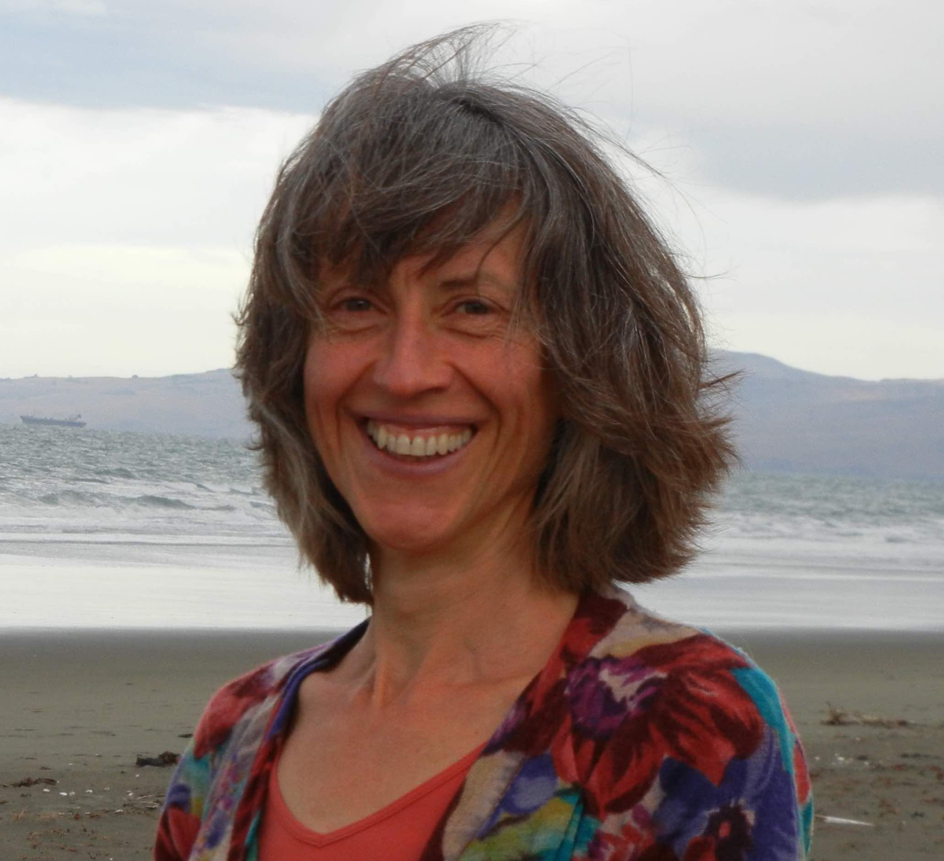
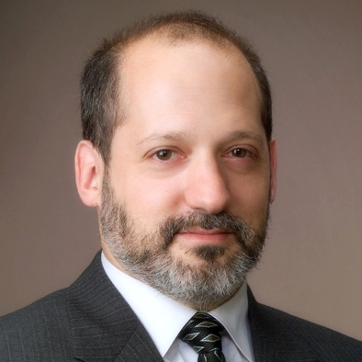

HayWired Scenario - Insights
Ken Hudnut, Brad Aagaard, Anne Wein, Keith Porter & Laurie Johnson
Notes:
[ 0:00 ] Thank you, Dale, for your kind introduction. Thank you, also, for all that you’ve done to make the HayWired Scenario & Coalition happen. Your vision and spirit floated many boats on an infinitely rising tide. Later, I will introduce each of the next several speakers in this “HayWired Scenario – Insights” portion of the program, that is, Brad Aagaard, Anne Wein, Keith Porter and Laurie Johnson in turn. Their bio’s are contained in the program packet. Each had a major role in creating the HayWired Scenario. [ 0:25 ]

Slide 6
HayWired Scenario - Insights
Dr. Ken Hudnut
HayWired Scenario - The HayWired Scenario is not a prediction; it is a cautionary tale about impacts of one potential future earthquake and high risk in the San Francisco Bay Area, a place where humans and hazards collide.
Reducing Risk - The HayWired Scenario paints a vivid and scientifically realistic picture to help communities accurately envision their potential future risk; risk reduction saves lives and property. Over $50 billion already invested in seismic resilience ensures that major losses will be reduced, but additional risk reduction is needed.
Useful Science - Together, we can “Outsmart Disaster” by putting science into action. Let’s reduce estimated impacts of the HayWired Scenario by devising cost-effective resilience strategies to reduce risk.
Notes:
[ 0:25 ] Each of these world-renowned speakers has several ‘main points’ to make, and you’ll find these ‘main points’ are also all printed on the back page of the speakers’ bios in your package. We’ll flash these up on screen as each speaker comes up, so please, read quickly and pay close attention because we’re about to cover 594 published pages of the newly released USGS reports in half an hour. Each of us has boiled things down to the essentials. So enjoy! [ 0:51 ]

Slide 7
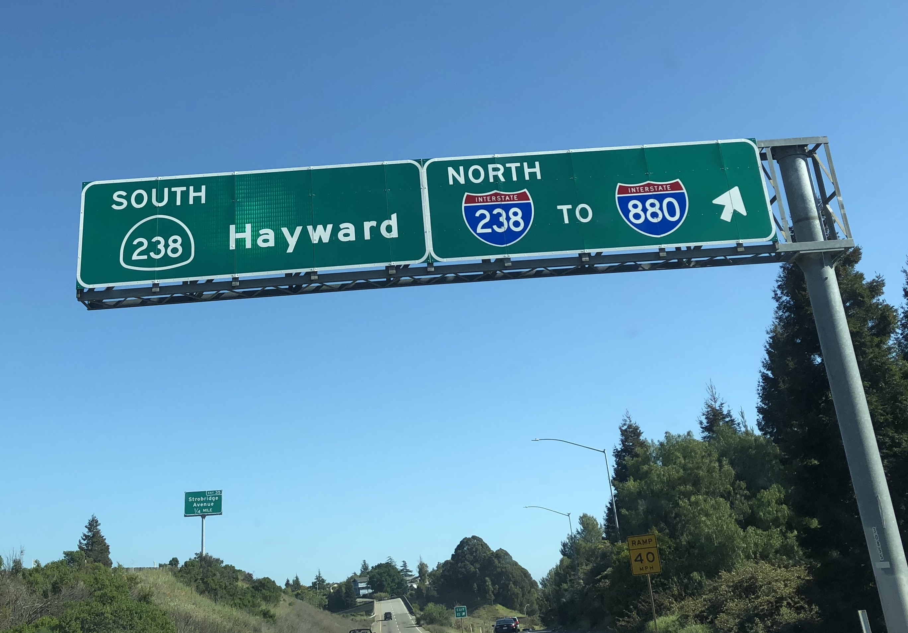
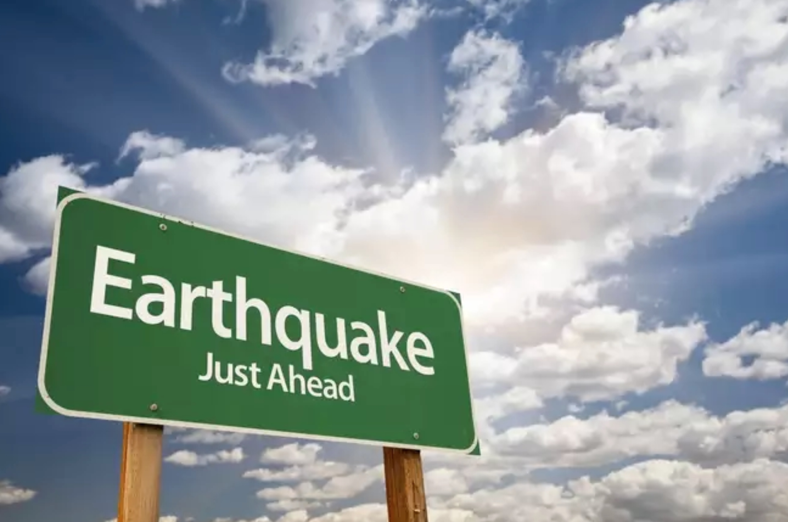
Notes:
[ 0:51 ] As we have planned today's event on the HayWired Scenario together, I have driven the full length of the HayWired Scenario rupture, and it’s long! Let’s compare this to a familiar event, the Aug. 2014 South Napa earthquake, which was less than 10 miles long and a magnitude 6. You can drive its full length in 15 minutes. The HayWired rupture is over 5 times longer and a magnitude 7, and it takes well over an hour to drive its full length. [ 1:18 ]
You get a sense of how much bigger and also how much, much more urban this scenario would be. Even though, technically, Napa was a ‘moderate’ earthquake, I have talked to the people of Napa, and I hear trauma in their voices, and stories of extremely disrupted lives and disrupted businesses. That was not a minor event, and they’re still recovering from it in many ways several years later. Starkly put, the Hayward Fault would unleash an energy release about 30 times bigger in this scenario, bisecting a heavily urbanized area where millions more people live. This scenario is at least ten times worse than Loma Prieta 1989.
[ 1:57 ]

Slide 8
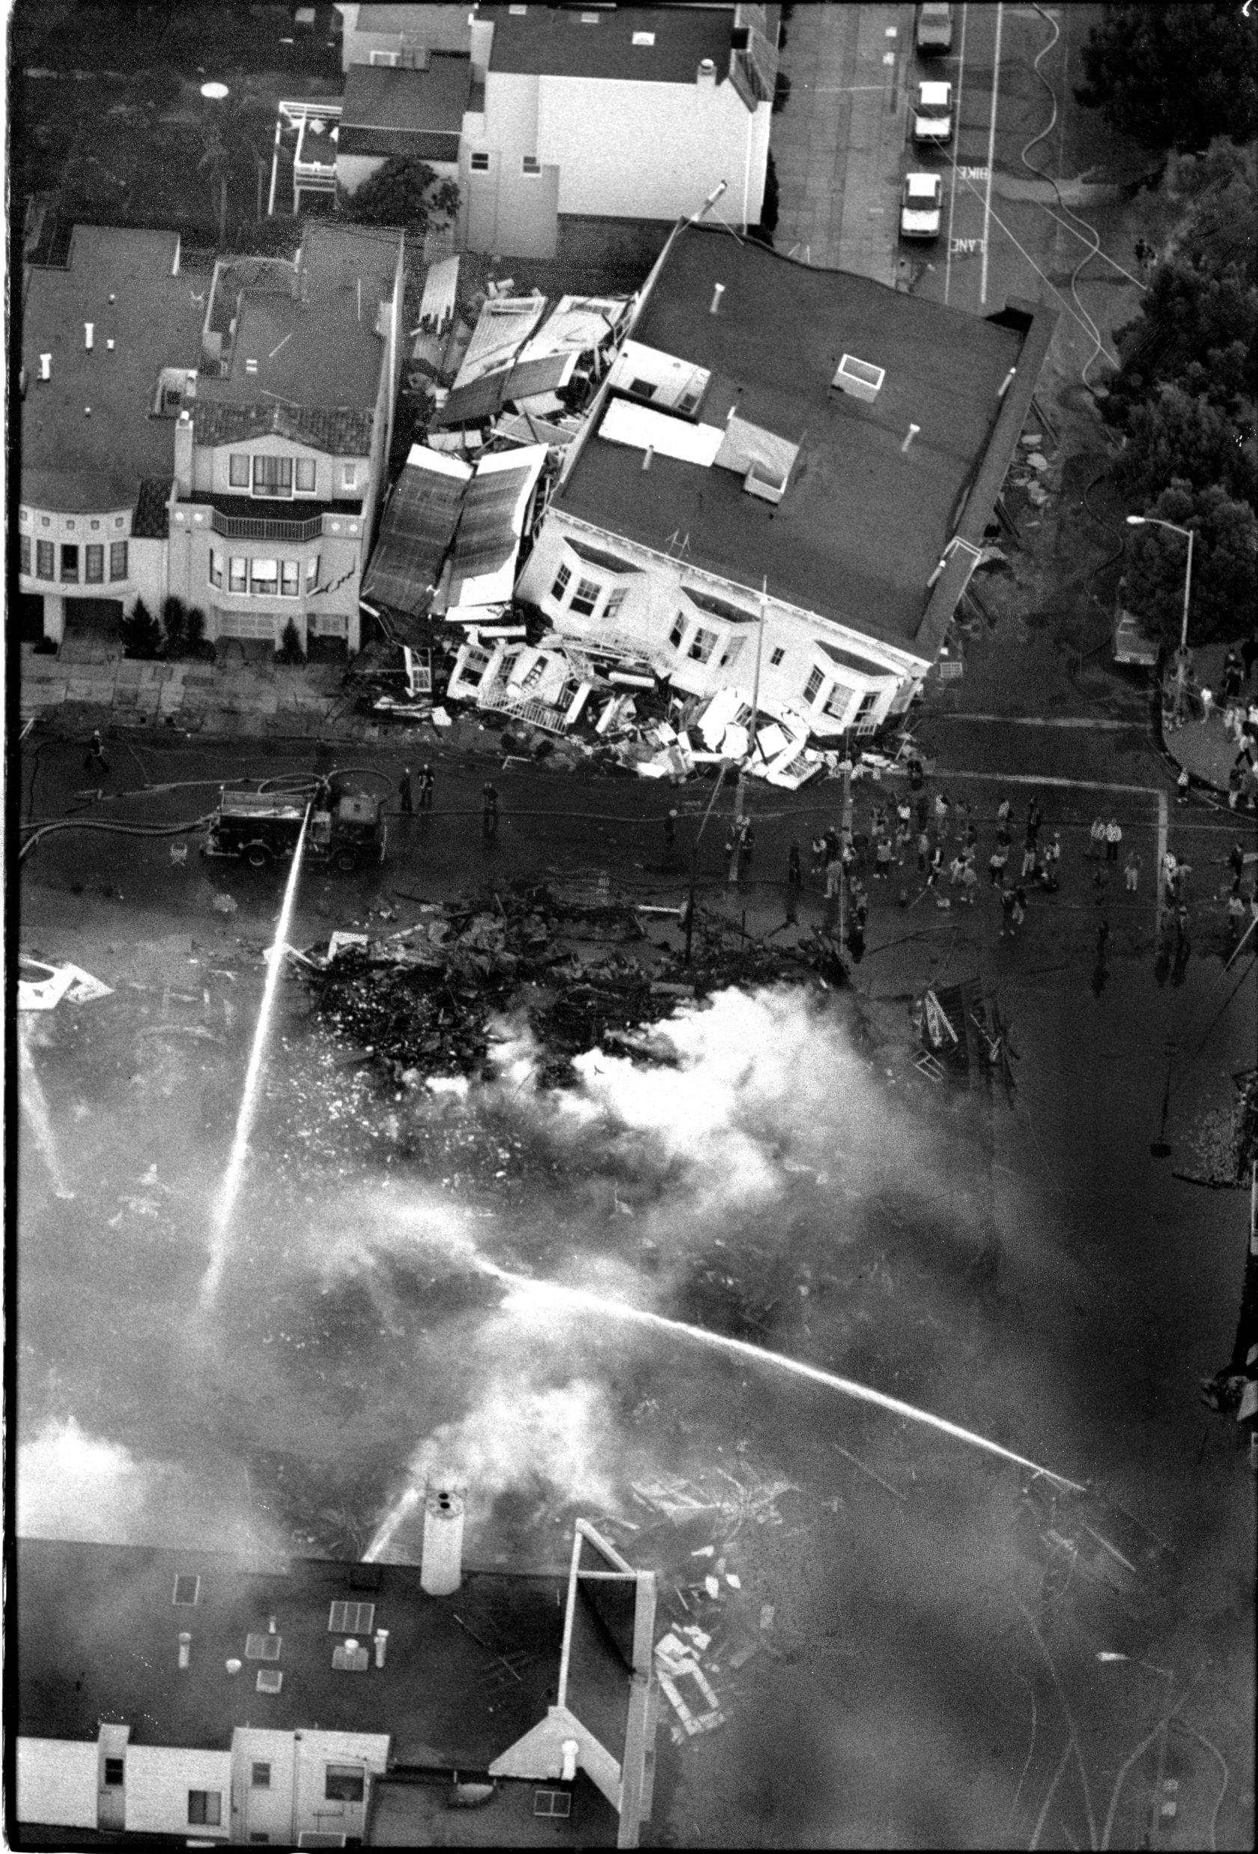
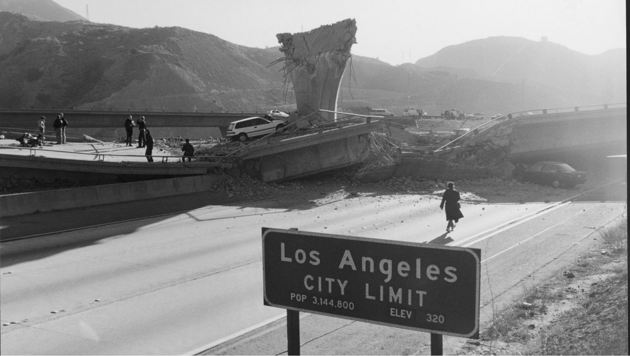
Steve Dykes / LA Times
Deanne Fitzmaurice / SF Chronicle / Polaris
Notes:
[ 1:57 ] We never know which of our “mega-cities at risk” will be struck next in a major disaster like the 1989 Loma Prieta or 1994 Northridge earthquake. We never know quite what cascading impacts will cause even greater disruption than we had ever envisioned. It's coming; it's not 'if,' it's 'when.' <pause> Literally nobody should be surprised by an urban earthquake that scores a direct hit, like in 1906. You may not know this, but 1989 & 1994 were bad, but they were not direct hits. We’re talking about worse, much worse, in the HayWired Scenario.

Slide 9
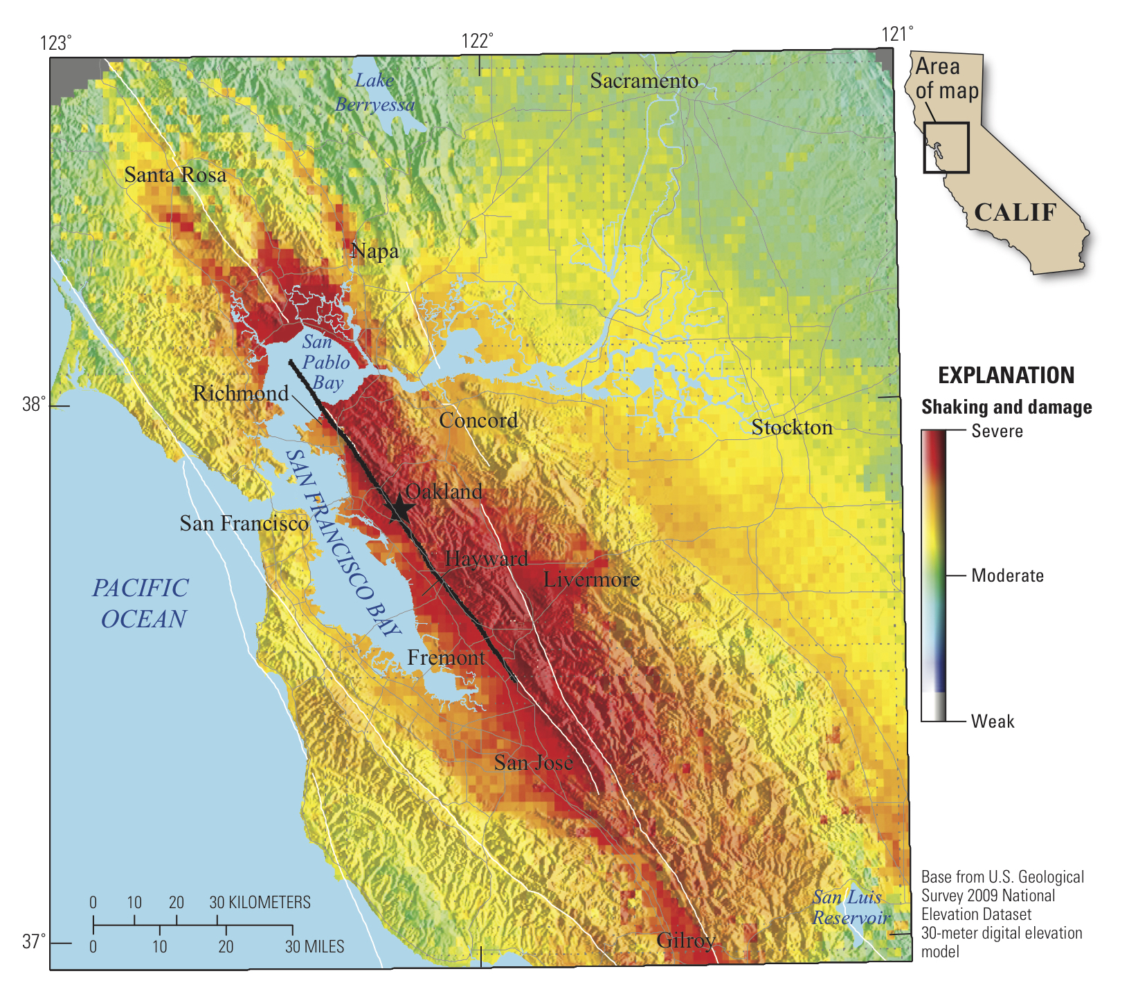
Notes:
It’s important to know what to expect, and to be ready for it. This is part of the package deal of living in the beautiful state of California that we call home. It’s on us to be ready; in many ways, we know what to do. In other ways, we need to keep innovating. That’s what we’re good at here. [ 2:50 ]
In the HayWired Scenario, 800 people die. <pause> Acceptable? <pause>
2,500 people need to be rescued from heavily damaged buildings, while another 22,000 are trapped in elevators. <pause> Acceptable? <pause>
Up to 152,000 households could be displaced. <pause> So many <pause>
[ 3:11 ]
Those staggering numbers you just heard in the movie are not un-change-able. We can change the outcome; we can save lives and reduce risk by taking action now. That’s our main message; not to frighten, but to empower. In many ways, we know – and our team has now stated in these new publications - what needs to be done. It is a matter of doing it to change the outcome. Prove us wrong! [ 3:35 ]

Slide 10
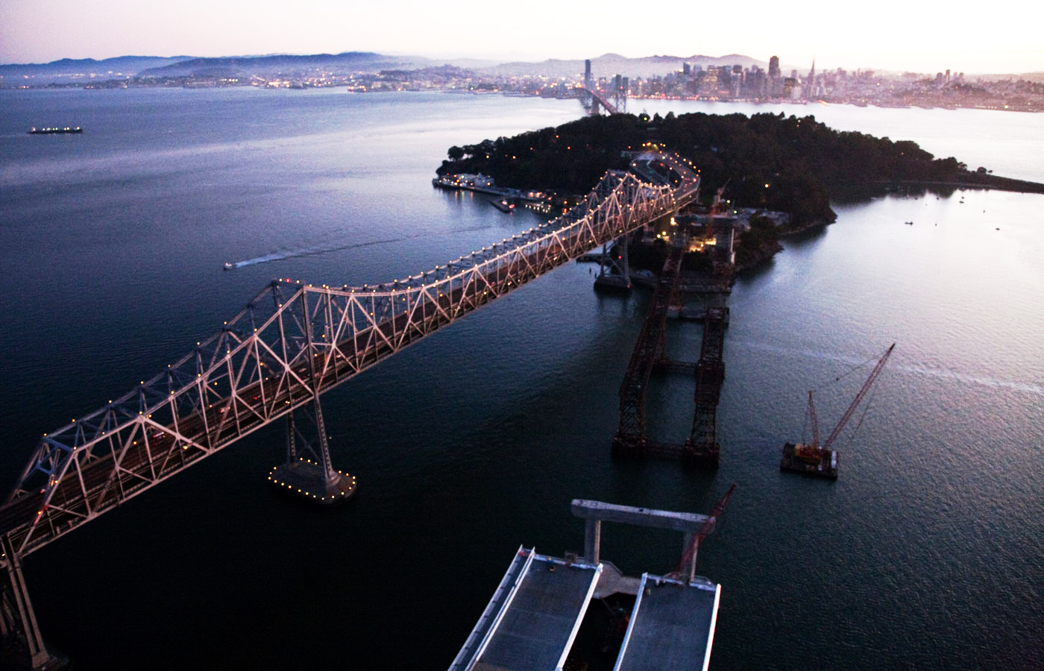
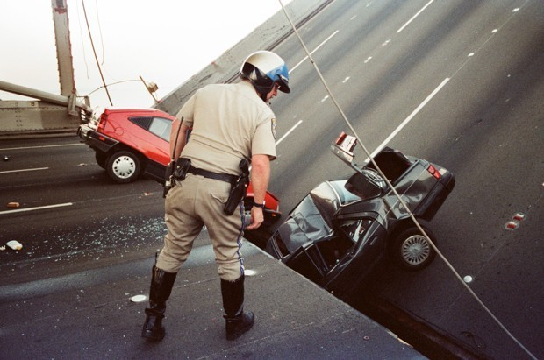
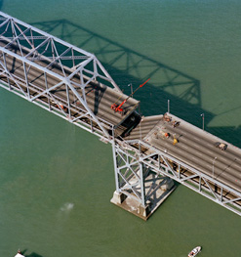
George Nikitin / AP
1989
Loma
Prieta
Bay
Bridge
Retrofit
Notes:
The HayWired Scenario is not a prediction; it is a cautionary tale about impacts of one potential future earthquake (of many possible) and the high risk in the San Francisco Bay Area, a place where humans and hazards collide. [ 3:49 ]
Humans have always valued those who offer factually based yet dire warnings of events yet to come; these are vital for leaders to ensure national security by deciding to take actions to avert disaster. Many scientists and engineers before our time have done this.
[ 4:07 ]
The HayWired Scenario is the latest in a decades-long series of efforts to communicate the severity of the threat posed by the fault that crosses the football gridiron that we see immediately to our east. To our west, a panorama of the San Francisco city-scape, a city that is known worldwide for that great 1906 earthquake and fire that nearly broke it down to ruins, but the city rose from the rubble and the ashes stronger, because people intentionally ensured that would not happen again. The HayWired Scenario is not a prediction, but a new attempt to clearly foresee. Each day that ticks past, we still have time on our side.
[ 4:40 ]
But we cannot be complacent. There is urgency in our message. We aren’t going to sugar coat it, because it’s our job to give it to you straight up.
[ 4:48 ]
Reducing Risk - The HayWired Scenario paints a scientifically realistic picture to help communities envision their potential future risk; we know risk reduction saves lives and property. Over $50 billion already invested in seismic counter-measures will ensure that major losses will be reduced, but more risk reduction is still needed.
[ 5:06 ]

Slide 11
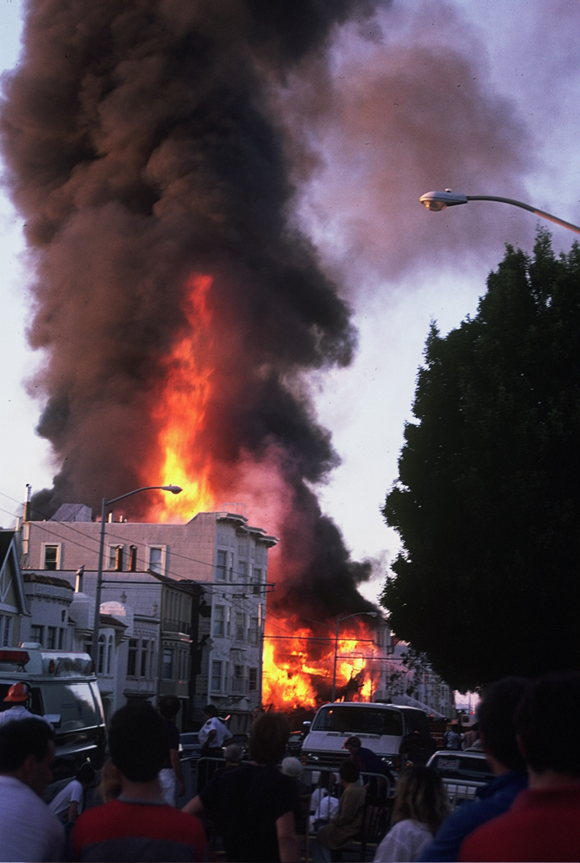
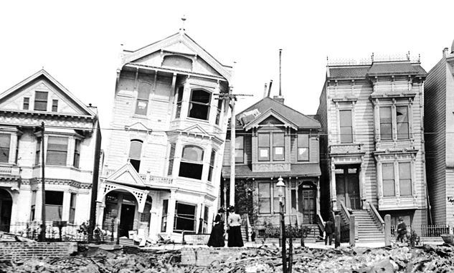
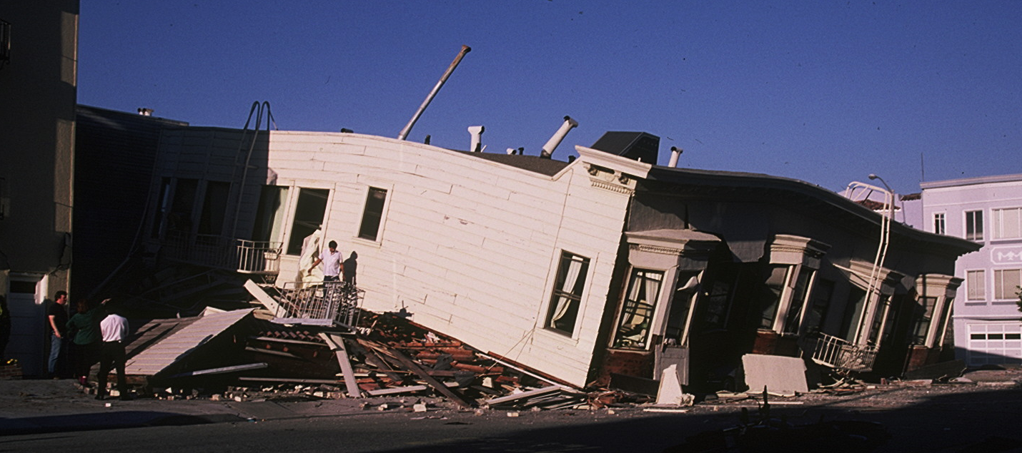
N. View from
Divisadero &
North Point
1906
Howard &
17th Streets
Liquefaction & ground motion amplifications
seen in 1868, 1906 and 1989 & HayWired
G.K. Gilbert / USGS
1989
Marina District; NW corner
of Scott & Divisadero
J.E. Estrem / USGS
Notes:
In their wisdom, people built back better after the 1868 and 1906 earthquakes, and they did so again after the 1989 Loma Prieta earthquake. And yet, as long as people live and work and commute and visit and sight-see in the SF Bay Area and rely on water, power, telecommunications and other key services that are at risk, work remains to be done. Look out there! Here, we see the area that was hit hardest in 1868 and also in the HayWired Scenario. Many ‘soft story’ apartment buildings, residences and other older mid-rise buildings have not been retrofitted. Our team's report finds many vulnerabilities and evaluates actions that, if taken, would save lives and property, and further avert tremendous economic losses.
[ 5:50 ]

Slide 12
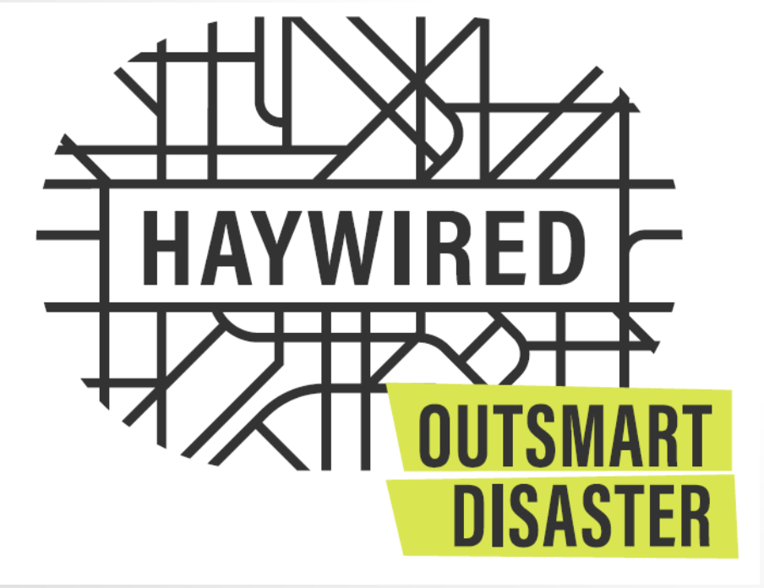
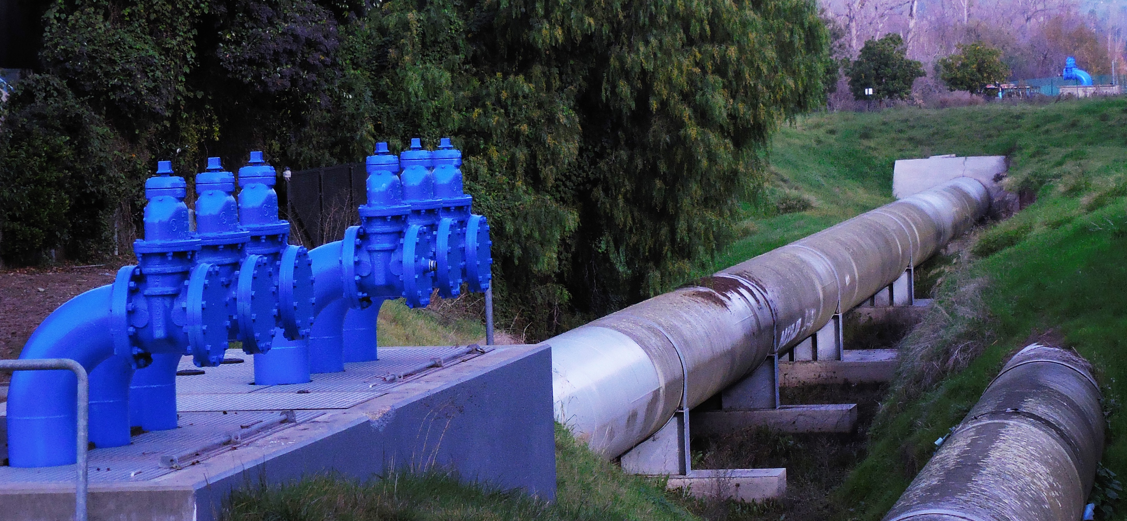
Together… we can #OutsmartDisaster
@HayWiredCA
Notes:
Useful Science - Together, we can “Outsmart Disaster” by putting science into action. Let’s reduce estimated impacts of the HayWired Scenario by devising cost-effective resilience strategies to reduce risk.
Let’s harness the creative energy and innovative spirit, especially of our young newcomers who never experienced a big earthquake. How can we motivate a new round of action? How can we engage our youth? Let's use our collective brains, our collective muscle, our collective will, and our collective resources, to re-ignite the old spirit of 1868, 1906 and 1989 and build back better before it hits next time.
[ 6:28 ]

Slide 13
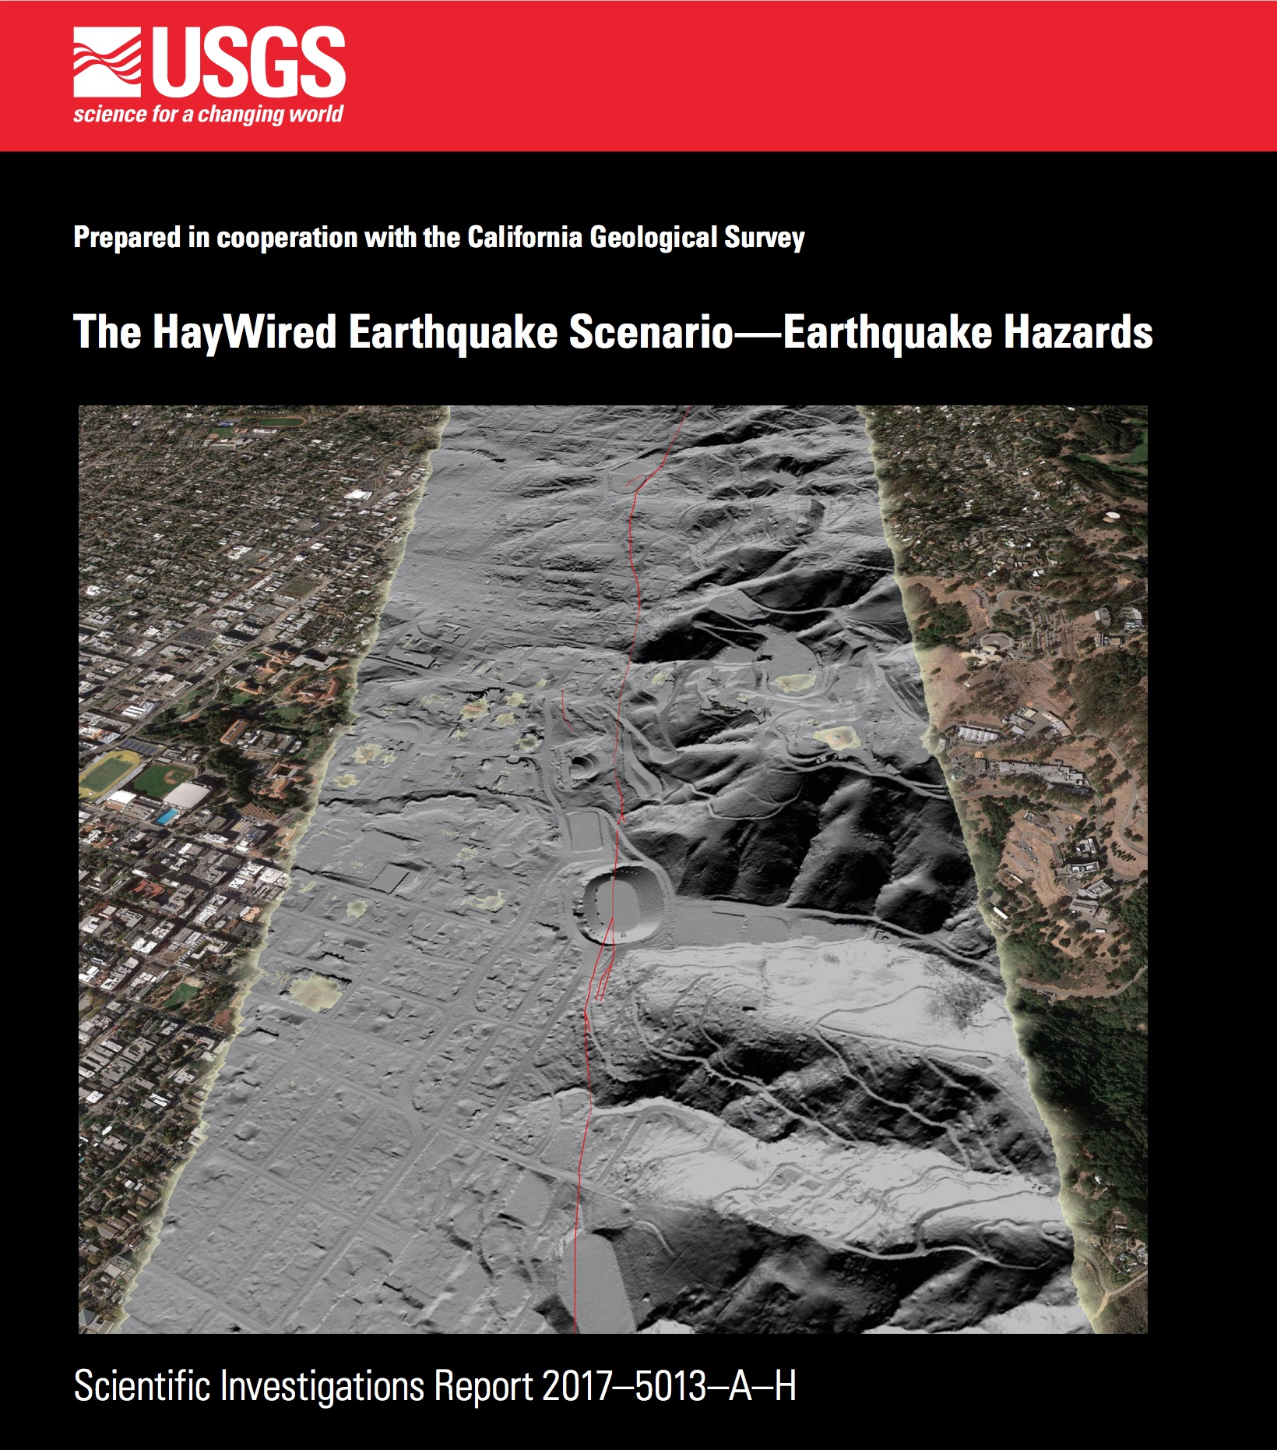
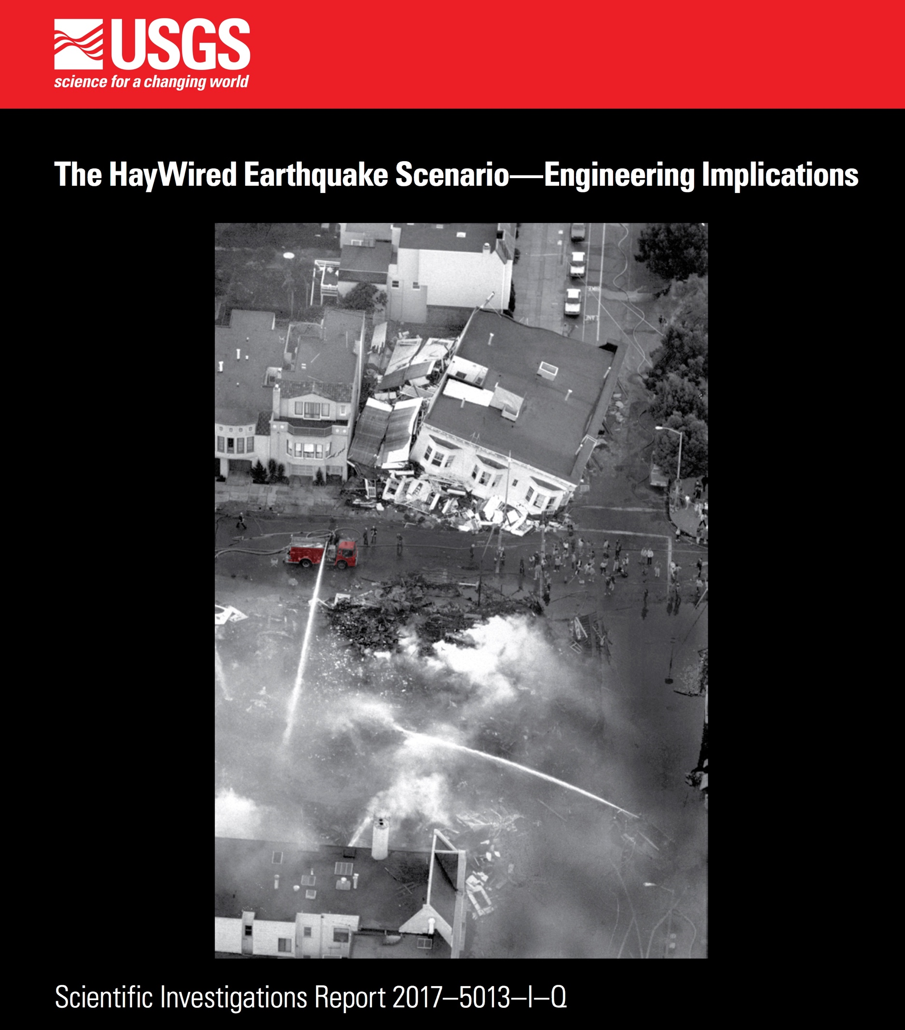
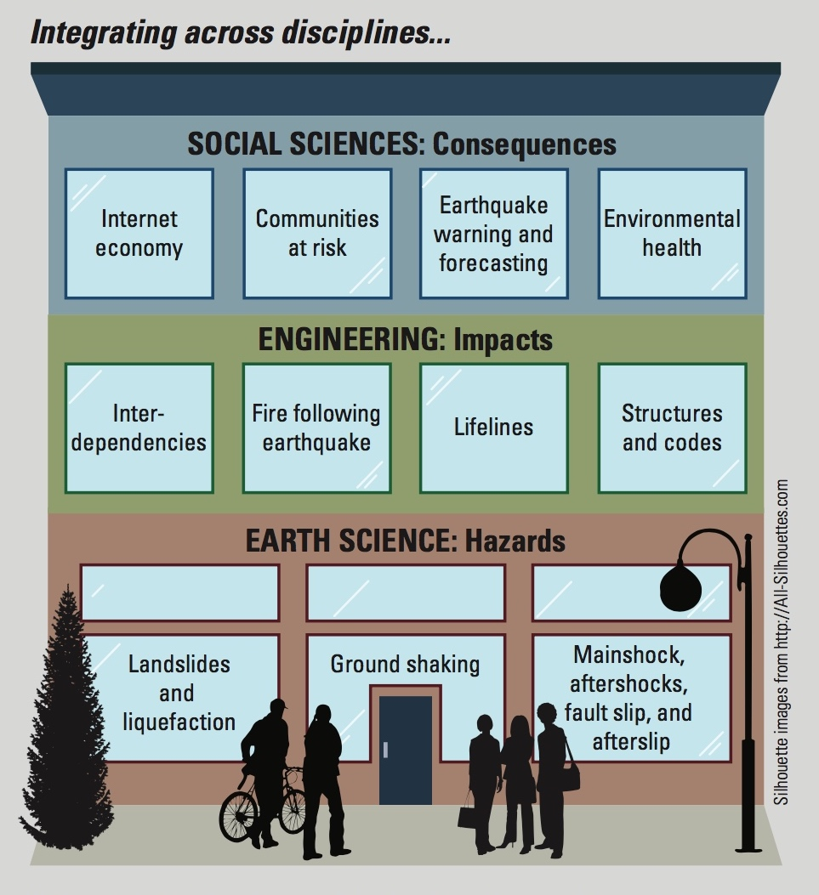
Notes:
Today, we have released both Volumes 1 and 2 of this USGS-led report and a USGS Fact Sheet that summarizes their contents. Together, these provide in-depth description of the earth science and impacts of the HayWired Scenario in unprecedented detail, as if the earthquake had just happened, and we are getting an initial clear look at damages. Then, in Oct. 2018, coinciding with the 150th anniversary of the last big rupture of the Hayward Fault, we will release Volume 3 of the report, which will be like a 6-month retrospective of the mainshock and major aftershocks, looking at the economic and social consequences with the benefit of hindsight.
[ 7:07 ]

Slide 14
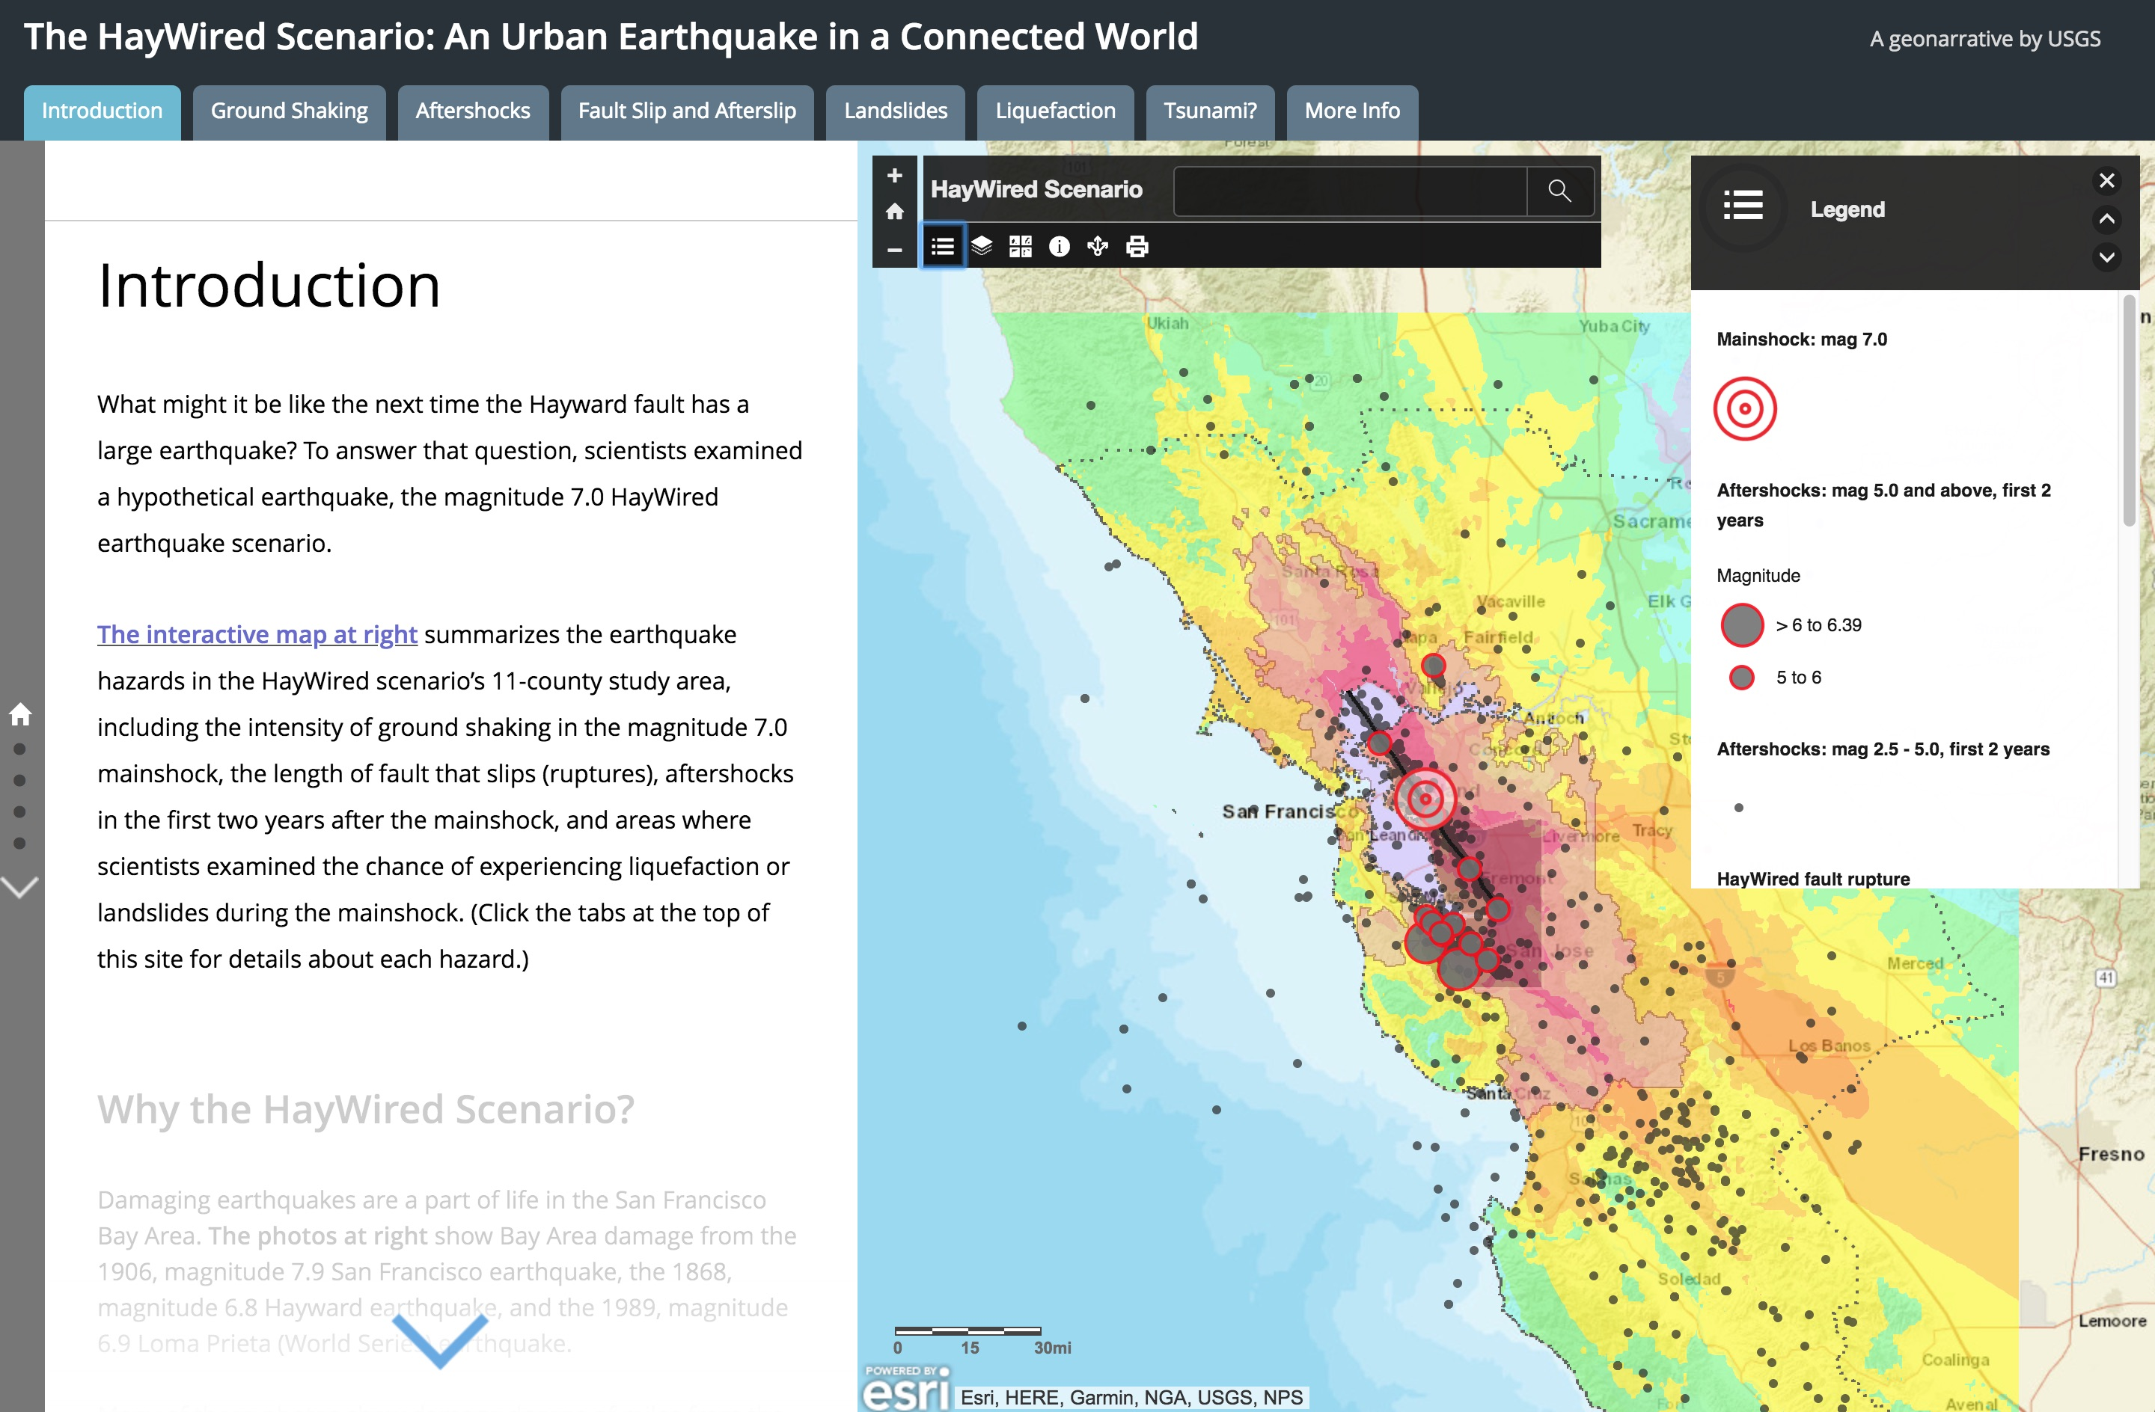
Notes:
Also today, we released two interactive and innovative new on-line products called geonarratives and provided a live demonstration of these earlier at Fremont. All of these USGS-led products are freely and openly available. Later, you will hear about how HayWired Coalition partners intend to make use of the HayWired Scenario in the future.
[ 7:43 ]

Slide 15
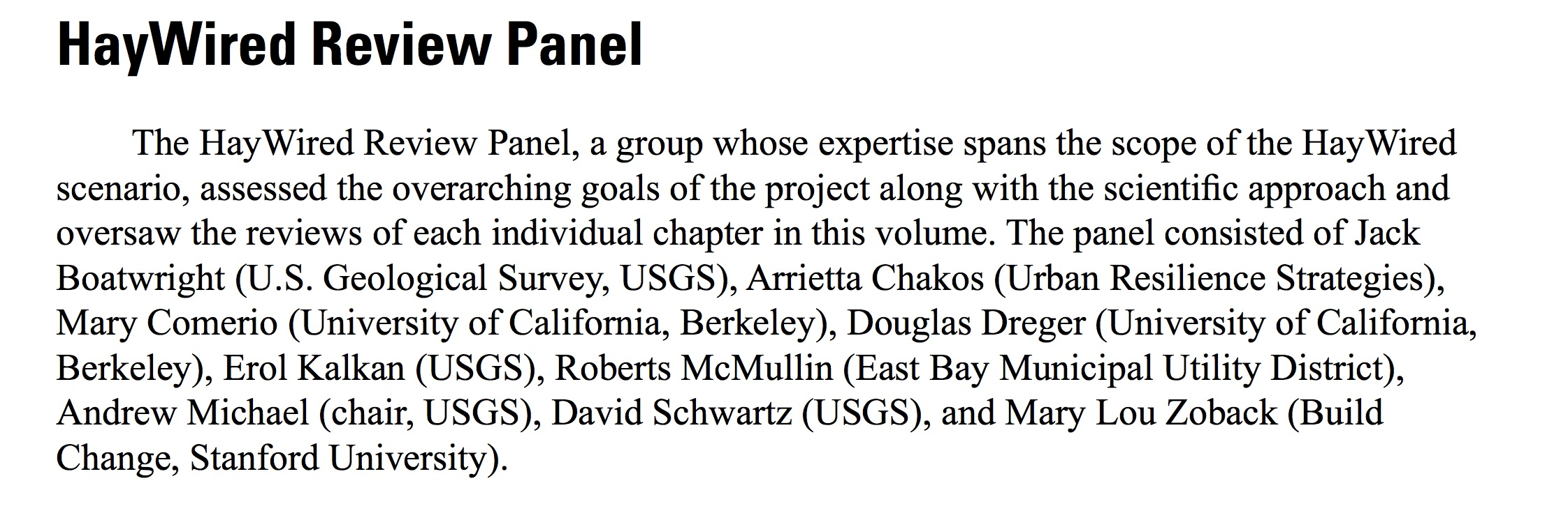
Notes:
The HayWired Scenario report is certainly the most heavily peer-reviewed and intensively scrutinized study ever conducted on the possible outcomes and impacts of a future Hayward Fault earthquake.
[ 7:35 ]

Slide 16
HayWired Scenario - Insights
Dr. Brad Aagaard
The Earthquake - The HayWired mainshock is a magnitude 7.0 earthquake that occurs on the Hayward Fault along the base of the East Bay hills; this earthquake would cause strong shaking over the entire San Francisco Bay Area with severe impacts along the fault.
Shaking Pattern - The shaking will be strongest along the fault and it will generally diminish with distance, but there will be locally intense shaking in some areas due to soft soils.
Ground Failure - The Hayward Fault will slip and then continue to move for months after the mainshock with the potential for recurring disruption of infrastructure. Widespread ground failure will also occur along the shores of San Francisco Bay in the form of liquefaction and in the East Bay hills as landslides.
Notes:
And now, I’d like to introduce our next speaker, Brad Aagaard.
[ 7:47 ]
Dr. Brad Aagaard is a research geophysicist with the USGS Earthquake Science Center in Menlo Park, California. He led an effort to model the ground shaking of the 1906 earthquake as well as the team of scientists that developed scenario earthquake models for the Hayward fault, one of which became the HayWired earthquake scenario.
[ 8:04 ]

Slide 17
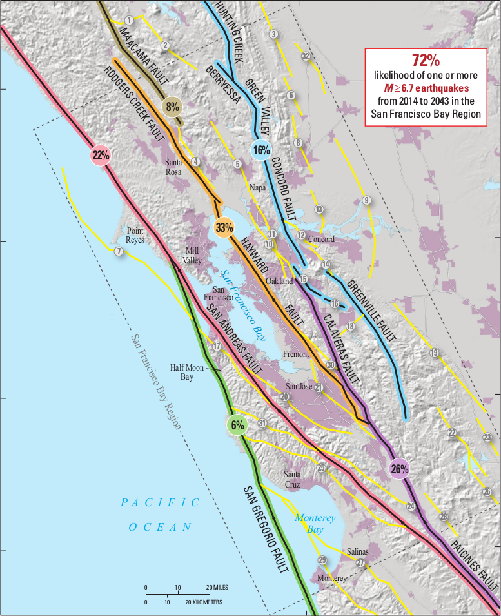
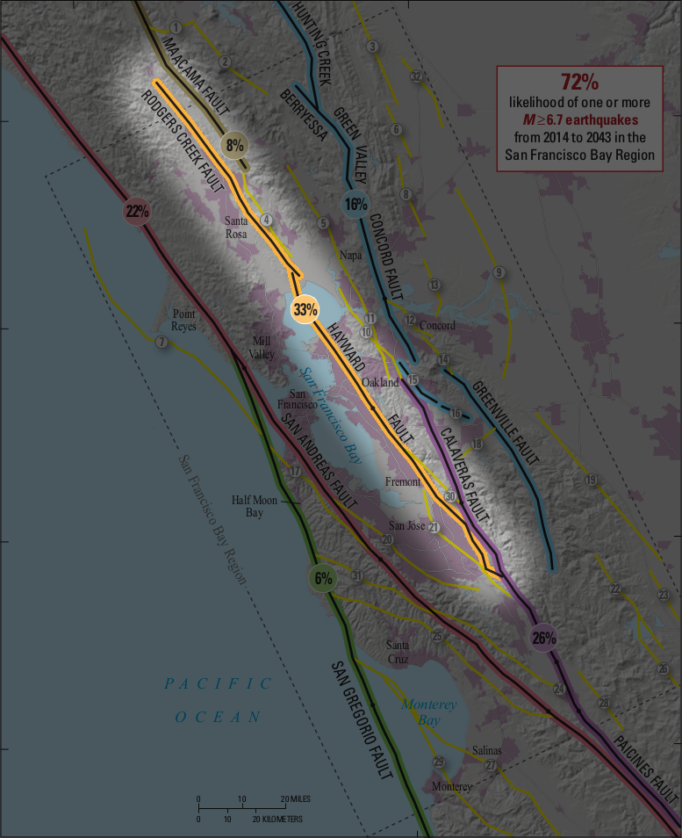
Earthquake Hazards
The San Francisco Bay region contains six major active faults.
There is a 1 in 3 chance of a M6.7 or larger earthquake on the Hayward Fault or Rodgers Creek Fault in the next 30 years.
Notes:
The San Francisco Bay region contains six major active faults. The San Andreas Fault is the most famous, having ruptured in the 1906 magnitude 7.9 earthquake. However, the Hayward and Rodgers Creek faults may be the most dangerous as they run directly through densely populated urban areas, including Fremont, Hayward, Oakland, Berkeley, Richmond, and Santa Rosa.
There is a 1 in 3 chance of a magnitude 6.7 or larger earthquake on the Hayward fault or Rodgers Creek fault in the next 30 years. This means that these two faults are the ones most likely to produce a large, damaging earthquake in the San Francisco Bay region in our lifetimes. 12 large earthquakes have occurred on the Hayward fault over the past 1900 years. The most recent one was in 1868, nearly 150 years ago.
Slide duration: 46s
Animation [Fade]: second text box with highlighting figure [Timing: Start=With Previous, Duration=0.5s; Delay=11.5s]

Slide 18
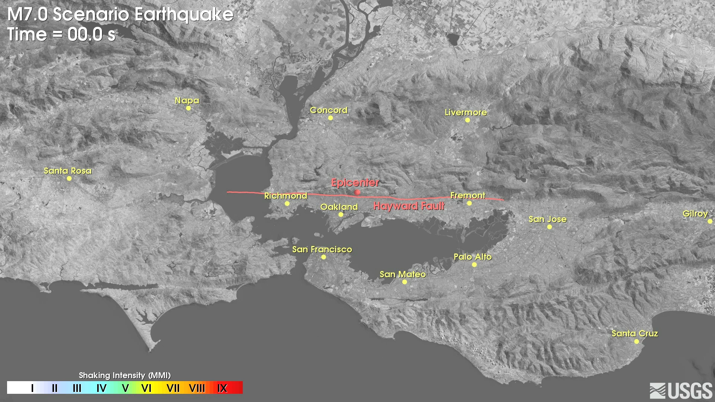
Ground Shaking
Notes:
The HayWired scenario mainshock is a magnitude 7.0 earthquake that occurs on the Hayward fault along the base of the East Bay hills.
The colors in the movie will show the intensity of ground shaking with orange and red indicating strong shaking. Once the maximum shaking is reached at each location, the color freezes so that the final image will be the maximum shaking at each location.
The scenario rupture starts beneath Oakland and propagates south toward Fremont and north toward Richmond. The shaking is severe along the fault, and it generally diminishes with distance. Within twelve seconds strong shaking envelopes the East Bay from Fremont to Richmond and east to Livermore and Concord. At 18s the main fault rupture is over, just as very strong shaking arrives in downtown San Jose.
In several locations, such as east San Jose, Livermore, and around San Pablo Bay, the shaking continues for more than 30 seconds as the waves bounce around in sediment filled basins. In these areas the ground moves about 2 to 3 ft back and forth in the horizontal direction.
This earthquake would cause strong shaking over the entire San Francisco Bay region with severe impacts along the fault, which cuts through some of the most densely populated urban areas in the region.

Slide 19
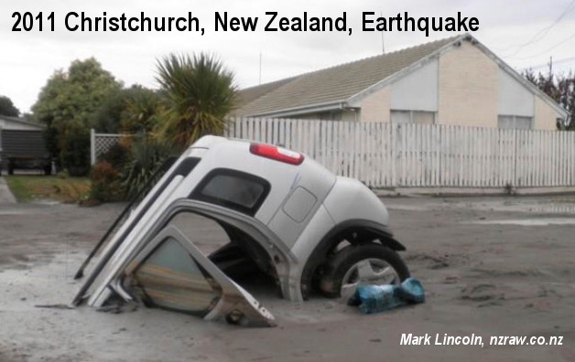
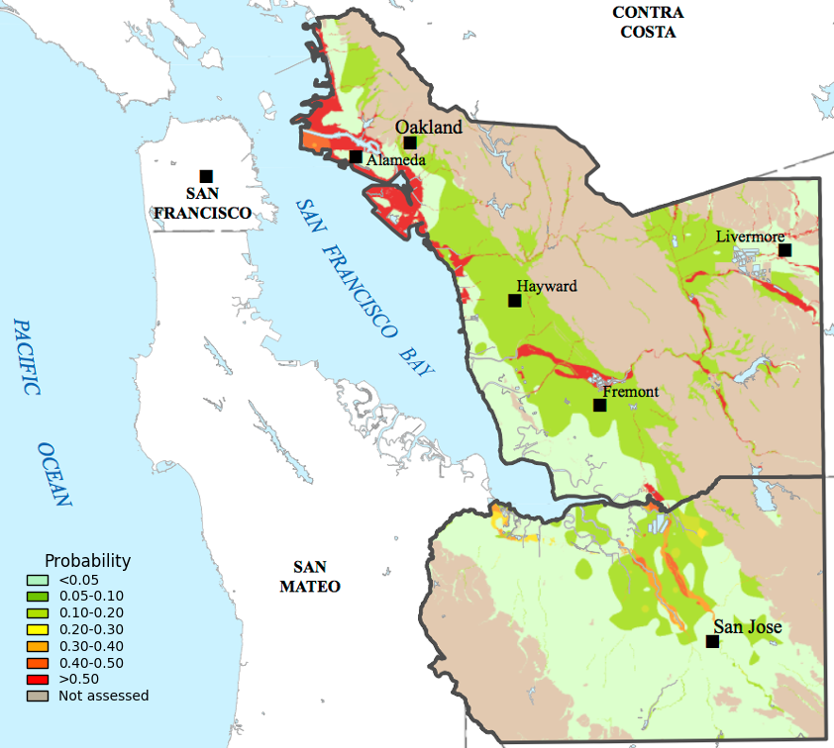
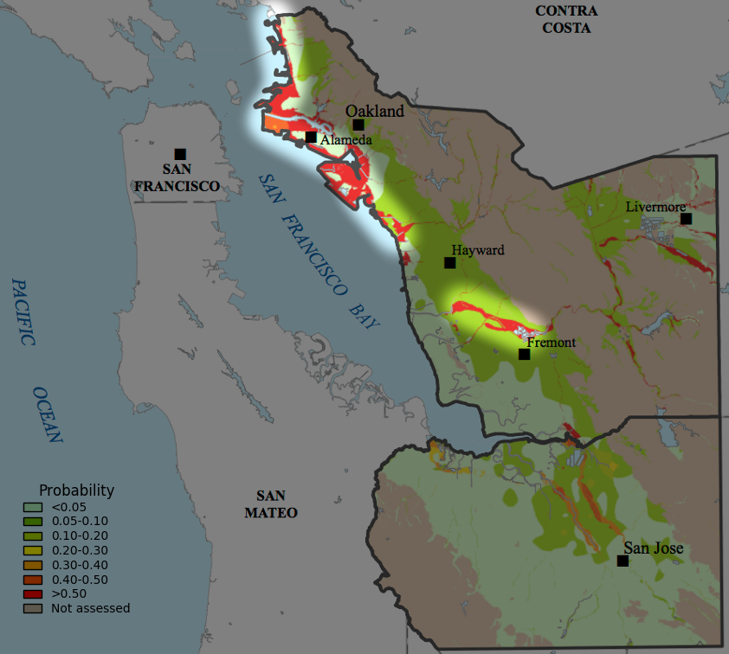
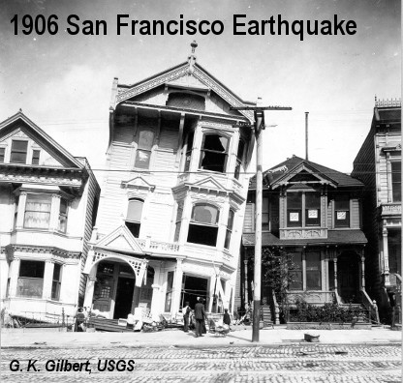
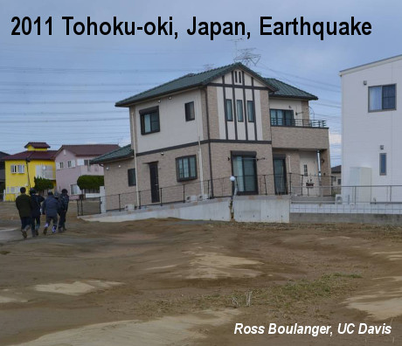
Liquefaction
Notes:
The shaking is strong enough in many places around the eastern margins of San Francisco Bay and along major creeks to cause the water-saturated soils to liquefy. This leads to deformation of the ground, causing settlement and lateral spreading. These vertical and horizontal movements of the soil cause severe damage to lifelines, structures and their foundations, and embankments. The most susceptible areas to liquefaction are the margins of San Francisco Bay in western Alameda County, including the shoreline in the cities of Alameda, Oakland, and Hayward. Liquefaction is also likely along Alameda Creek in Fremont and Union City.
Slide duration: 37s
Animation [Fade]: highlighting figure [Timing: Start=With Previous, Duration=0.5s; Delay=25s]

Slide 20
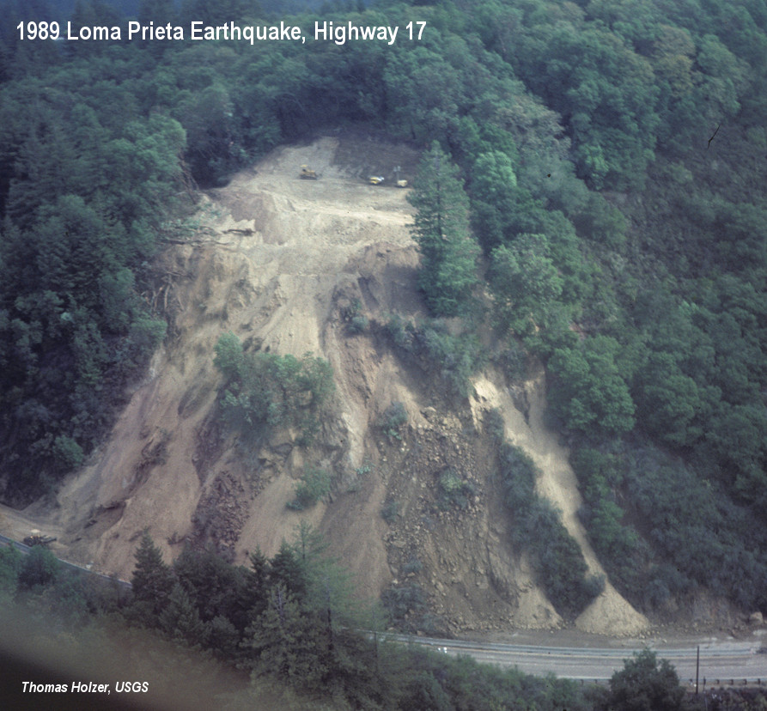
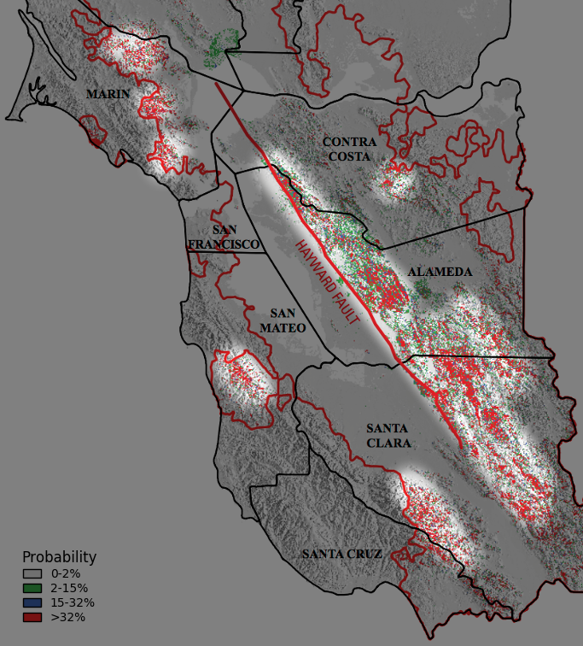
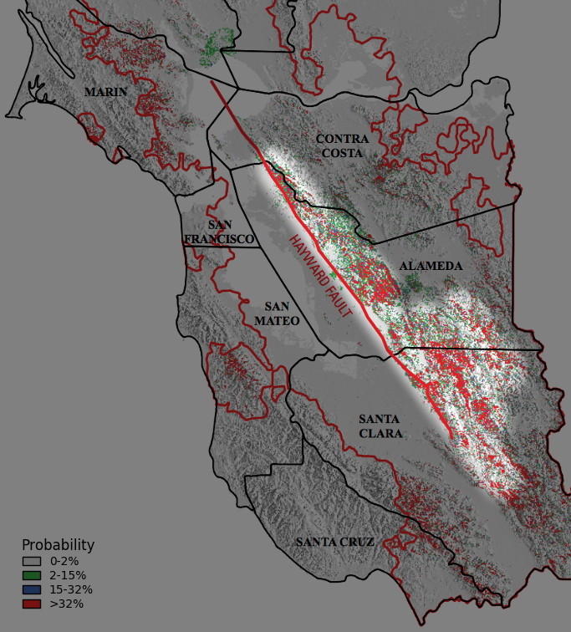
Landslides
Notes:
As a result of the strong shaking, landslides may occur on many of the moderately steep and steepest slopes in the East Bay hills. Landslides may also occur on the steepest slopes in the hills throughout the rest of the San Francisco Bay region. Some of these are new landslides while others are reactivation of existing ones. These landslides will damage infrastructure in hillside areas, and roads will be blocked by landslide debris.
Slide duration: 25s
Animation [Fade]: highlighting figure [Timing: Start=With Previous, Duration=0.5s; Delay=10s]

Slide 21
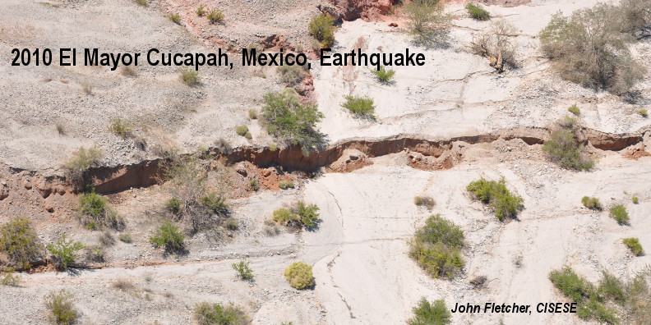
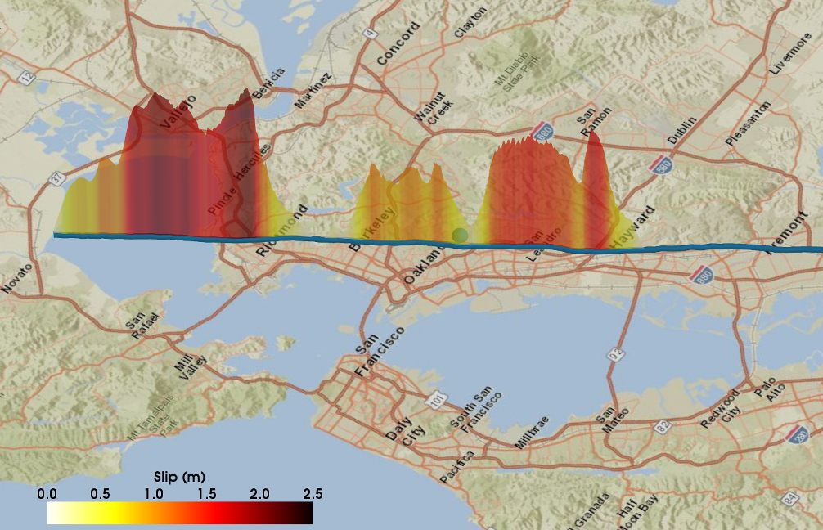
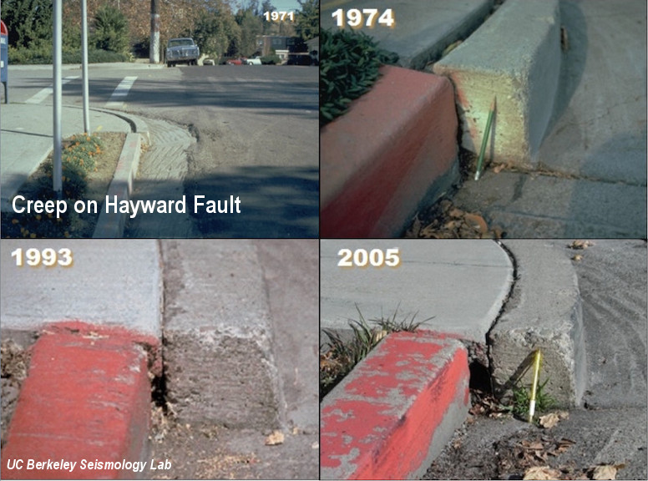
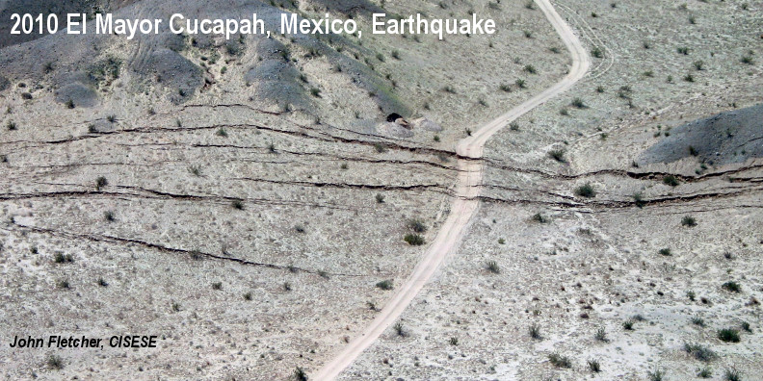
Surface Slip and Creep
Notes:
The HayWired scenario mainshock produces ground surface displacement across the fault of nearly 8 ft in the Richmond area and 3-4 ft at many locations from Berkeley to Hayward within the 18 seconds that it takes for the earthquake rupture to occur. This will cause severe disruption to facilities and systems straddling the fault, such as buildings, pipelines, electrical transmission lines, roads, bridges, and tunnels.
Some locations along the Hayward fault experience very slow slip between large earthquakes. The effects of this slow slip or creep at the surface are visible at numerous locations along the fault in the form of offset curbs, cracked pavement, and deformed fences. At these locations rather than the several inches of slip that have occurred over the past few decades, we expect several feet of accelerated creep to occur in the days, weeks, and months following the mainshock. This accelerated creep will cause additional damage to infrastructure crossing the fault and complicate repairs due to the ongoing deformation.
Slide duration: 60s
Animation [Fade]: surface rupture photos disappear, creep photos appears [Timing: Start=With Previous, Duration=0.5s; Delay=25s]

Slide 22
Understand Hazard to Reduce Risk
Although we cannot prevent large earthquakes like the HayWired scenario from occurring, we can continue to use our science to mitigate their impacts on our interconnected world.
Notes:
Although we cannot prevent large earthquakes like the HayWired scenario from occurring, we can continue to use our science to mitigate their impacts on our interconnected world.

Slide 23
HayWired Scenario - Insights
Dr. Anne Wein
Aftershocks –After a large earthquake is not the time to relax. Aftershocks extend the duration of disruption and can require repeated repairs and inspections for months to years.
Wired – Earthquakes damage telecommunication infrastructure and cause power outages, while our need to connect with friends and relatives will overload compromised networks. You need power and connectivity to plug in.
Alerts - Realtime ShakeAlert messages could prevent injuries by providing valuable extra seconds to drop, cover, and hold on prior to the arrival of very strong shaking in some areas.
Notes:
Dr. Anne Wein, a Decision Scientist with the USGS Western Geographic Science Center, has coordinated analyses of societal consequences for all four SAFRR scenarios since 2006. She studied the communication of aftershock forecast information during the 2010 through present Canterbury, New Zealand earthquake sequence. [ 0:18 ]

Slide 24
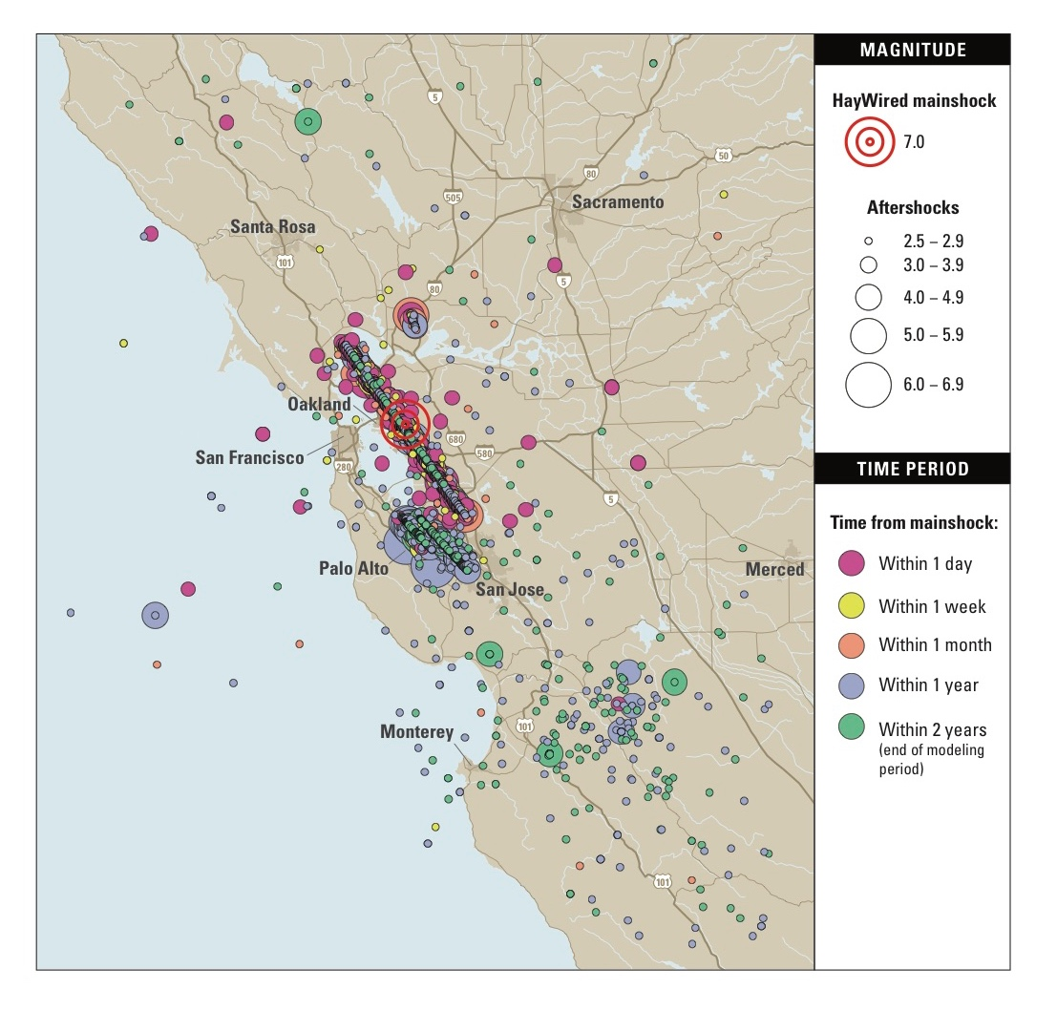
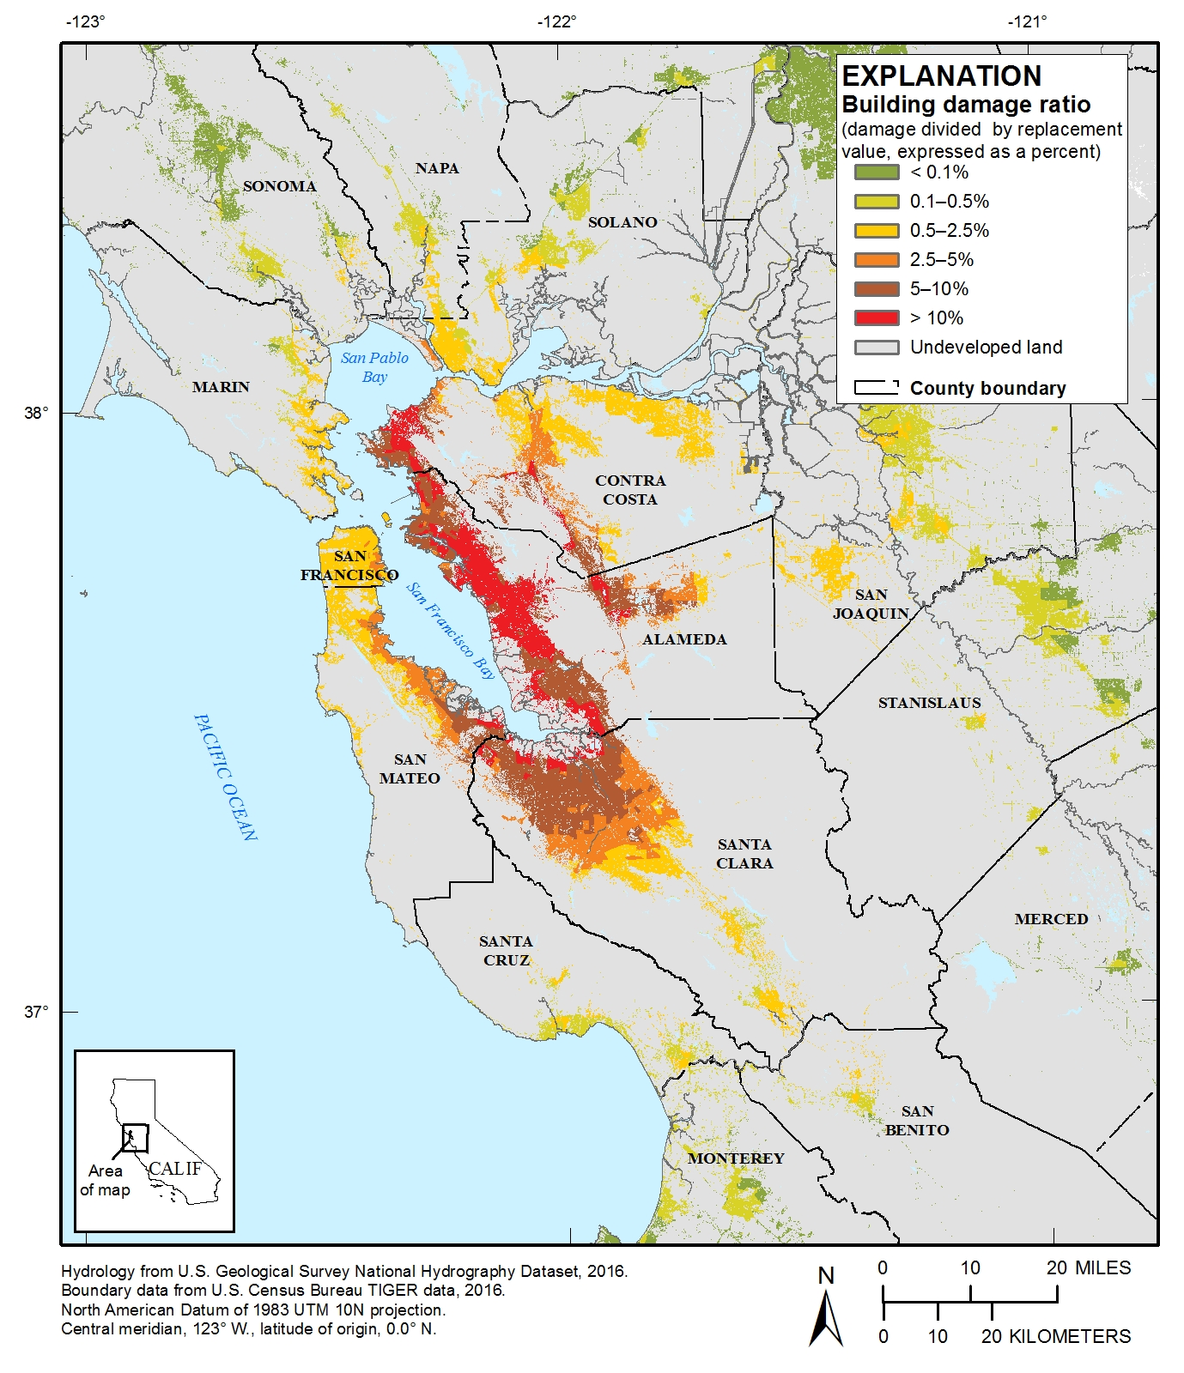
Aftershocks – not a time to relax
HayWired Earthquake Sequence
16 aftershocks >Magnitude 5
$70 B Cumulative Property Damage:
Percent loss in developed areas
Notes:
My home town is Christchurch, New Zealand. The city has been battered by aftershocks since a magnitude 7 earthquake in 2010. Aftershocks closed the Central Business District for years. I witnessed how aftershocks cause stress from traumatic experiences and future uncertainty, how they aggravate and repeat damages that threaten life safety, and how they set back recovery.
To complete the set of earthquake hazards in volume I, the HayWired scenario is a series of earthquakes in time, space and magnitude. The earthquakes cluster around the Hayward fault. One possibility, of many, is that they move on into Silicon Valley.
16 magnitude 5 and greater aftershocks show that liquefaction repeats in the soft soils, show that unreinforced masonry and Tilt up buildings are vulnerable, and show that a few areas are more impacted by an aftershock than the mainshock.
Throughout the sequence, property losses amount to 70 billion dollars and 20% of the shaking damages to buildings accrue from aftershocks.

Slide 25
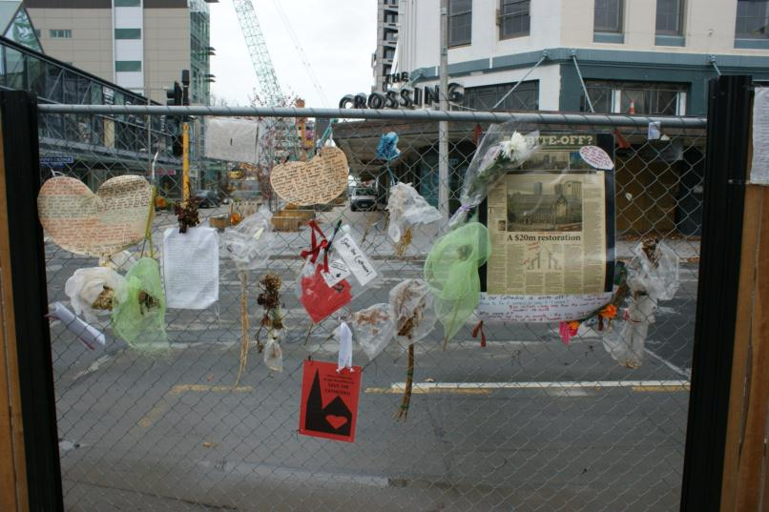
Aftershocks – Not a time to relax
HayWired Aftershocks: Time series of earthquake magnitudes
Christchurch CBD: Behind the cordon
Photo: Laurie Johnson, 2011
Notes:
In the first week after the mainshock, throughout the Bay Area, people could feel hundreds of earthquakes and a few could be damaging. The number of earthquakes would drop off over time, but larger aftershocks would increase the numbers of earthquakes again.
In New Zealand, during the Christchurch earthquake sequence, we learned
It is hard for scientists to get people’s attention about aftershocks after surviving a big earthquake.
There is tension between life safety and business access decisions.
There is a fear of causing panic from communicating the aftershock forecasts with the public.
We found that
Earthquake forecasts can help people cope when they know that the aftershocks are normal and that scientists understand.
Also, that earthquake forecasts can be used by community leaders and emergency managers during response and recovery. Although, these decision-makers could be better prepared to use aftershock forecasts.

Slide 26
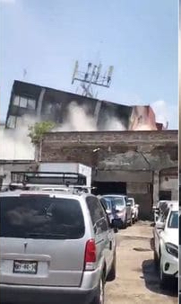
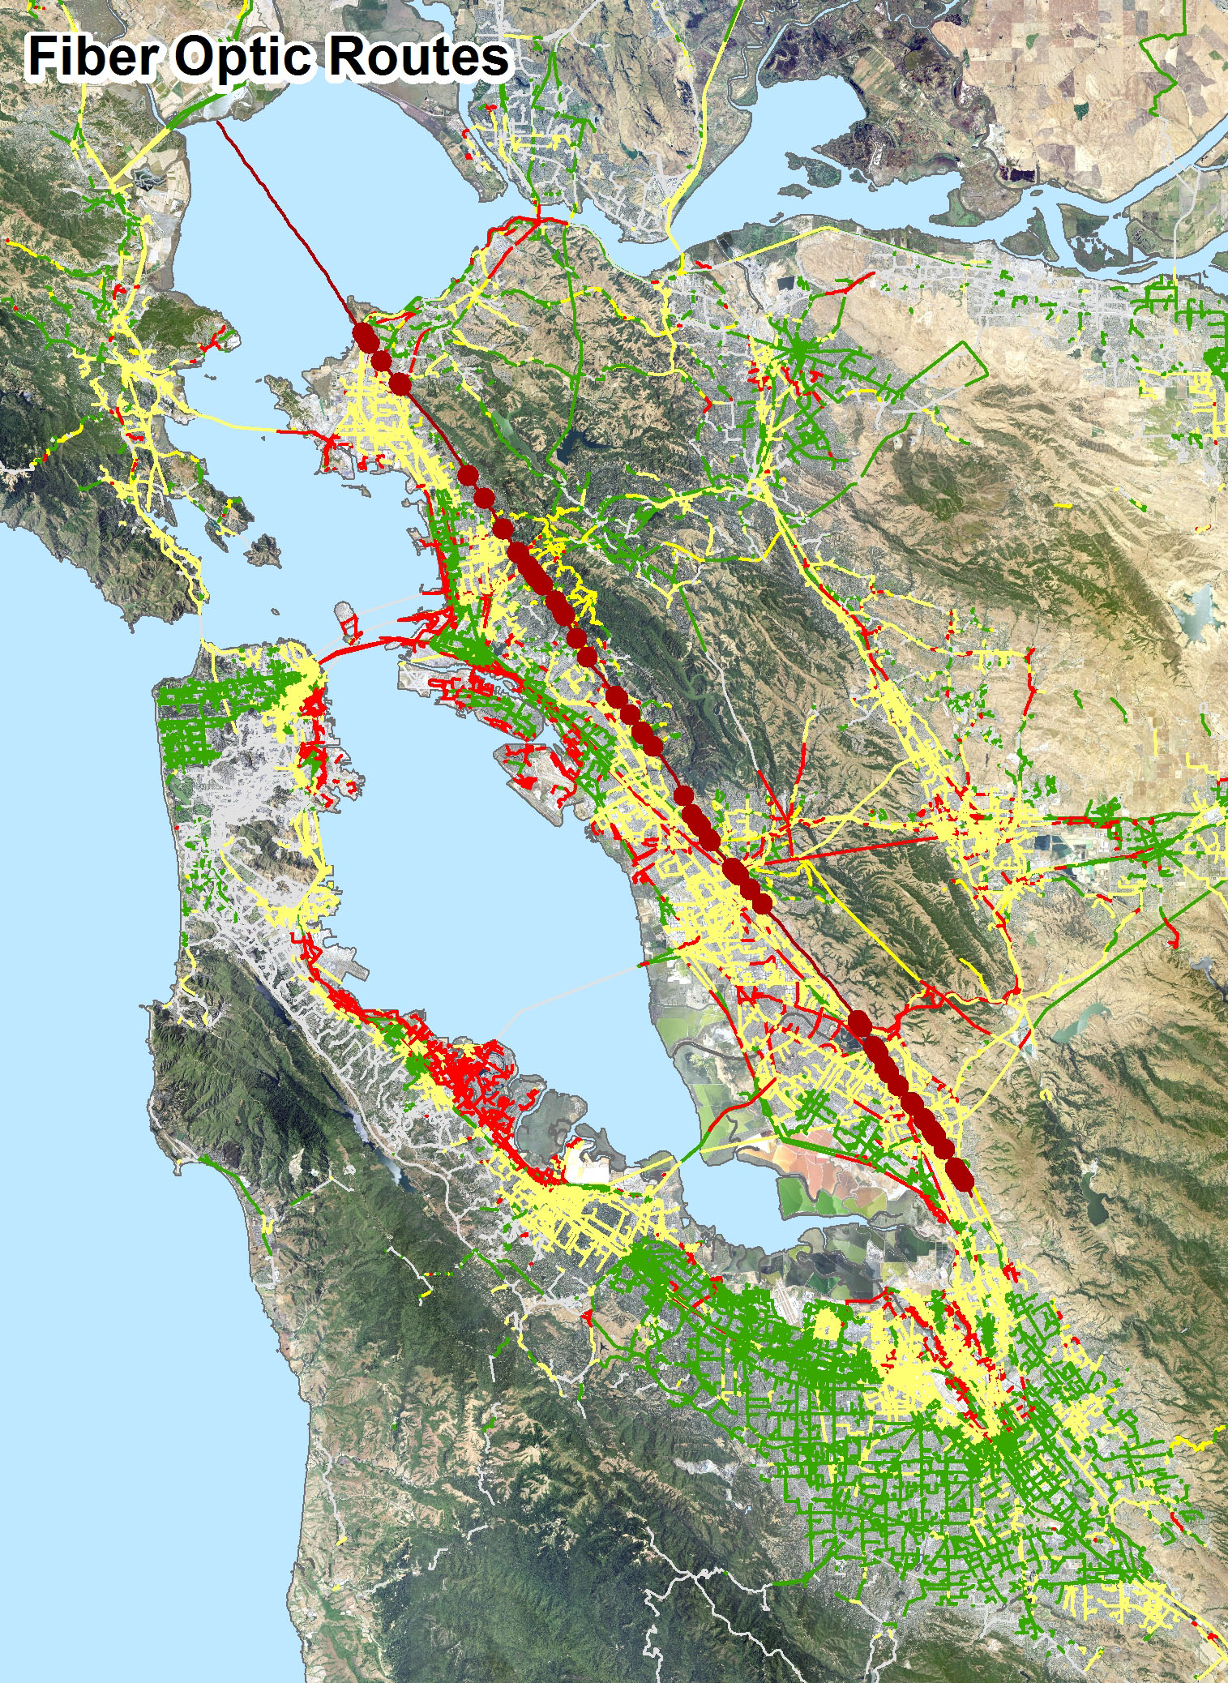
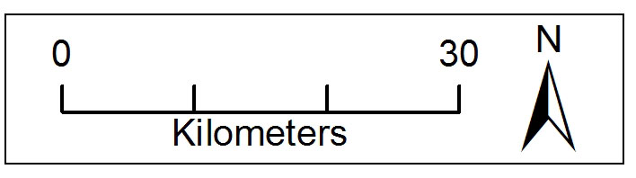
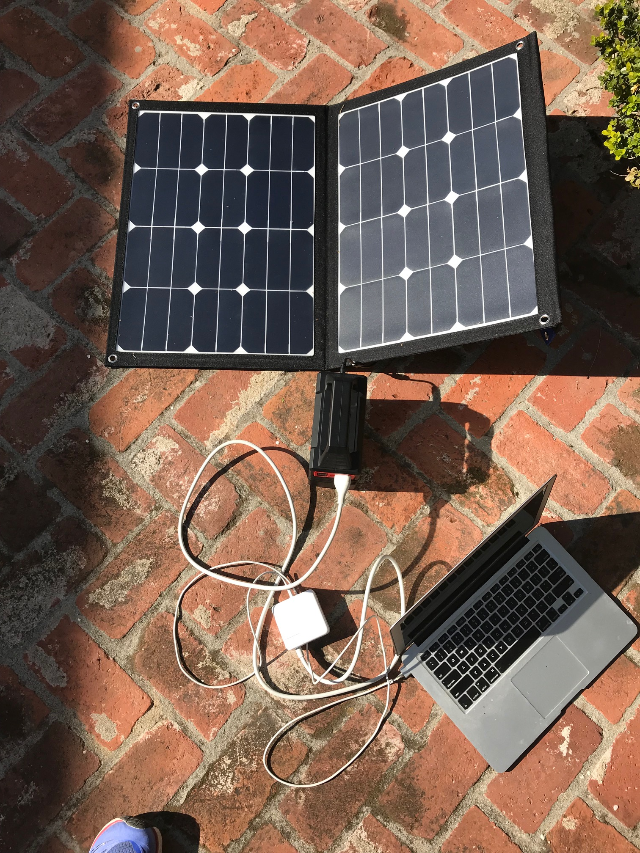
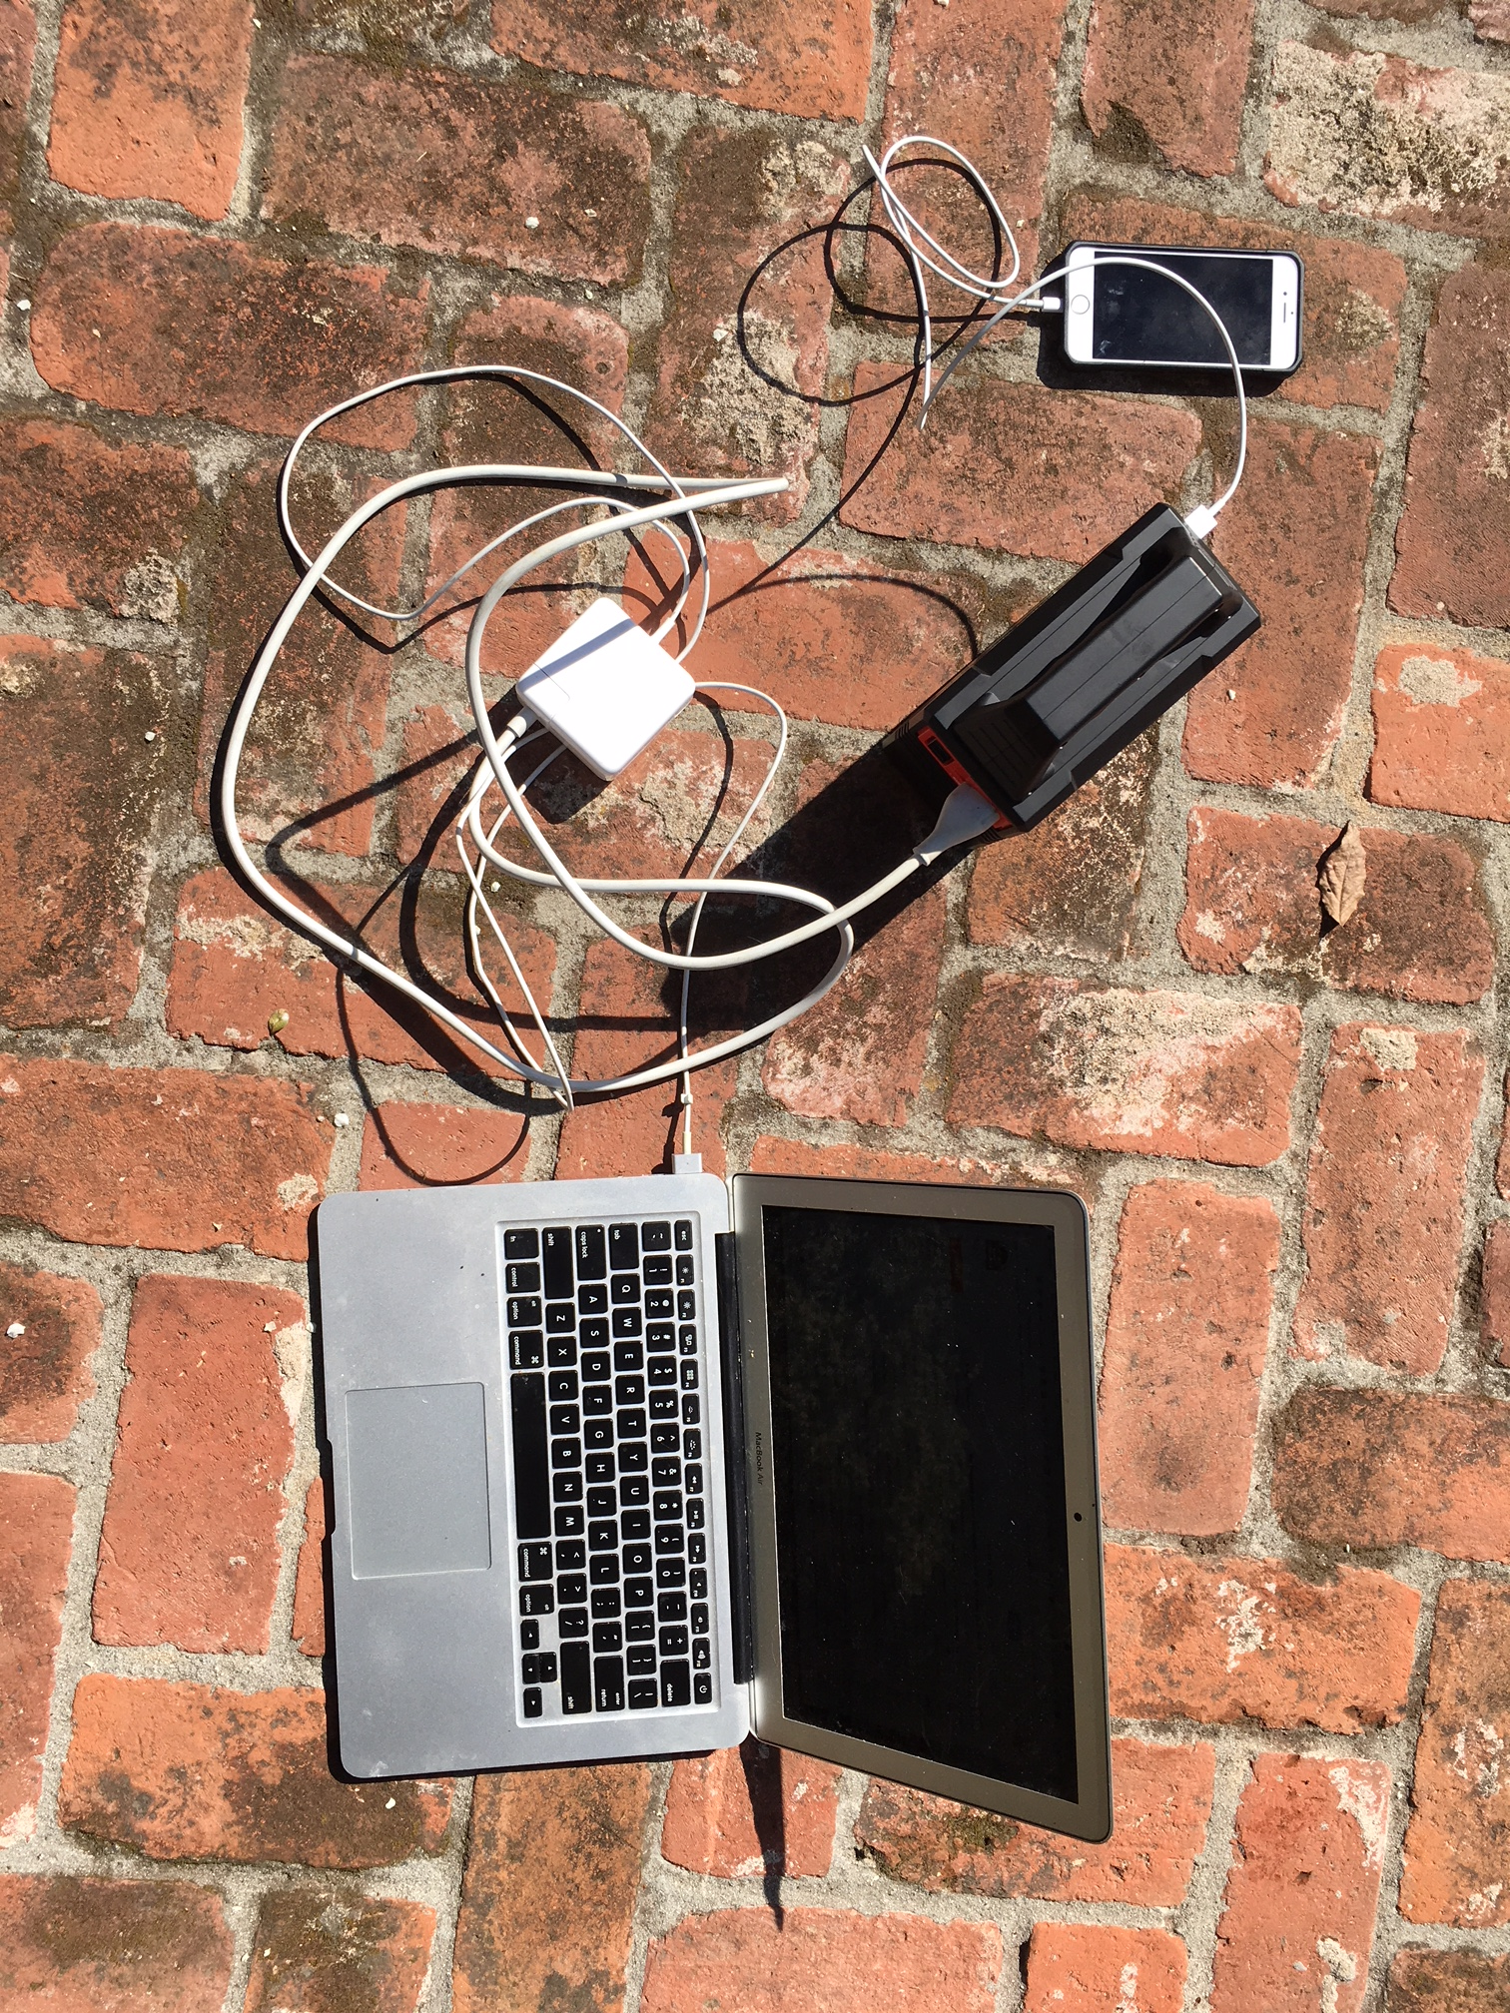
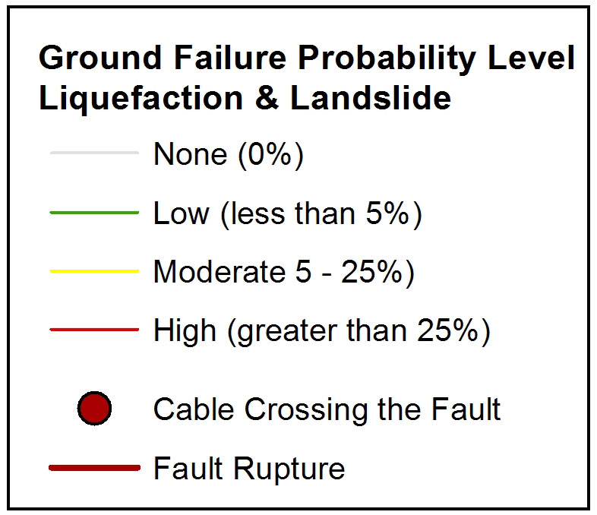
Wired – Phone, Internet, Power Outages
Cell Site during 2017 Central Mexico Earthquake
www.youtube.com/watch?v=qPImJ2mFH0c
Notes:
HayWIRED considers impacts of earthquake hazards on phone and internet services, that today are inseparable (e.g. Voice over IP).
We expect some damage to cell sites, central offices, and equipment -- also, breaks in connections in the network that distributes voice and data services. More than 200 fiber optic cables cross the fault rupture and kilometers of cables run through liquefaction, landslide, and fire hazards.
Like the North Bay fires, communications would be immediately essential for life safety. Like the North Bay fires, a large earthquake will ignite simultaneous fires, counties won’t be able to call on each other, some backup generators will not perform as expected, and a fear of causing panic could interfere with warnings. Less like the North Bay fires, power outages caused by the earthquake could slow down potential cascades of electric fires. All the same, 9-1-1 will be overwhelmed and standardized alerts would be needed to help people make decisions to protect themselves
When we connect with family and friends, we will overload remaining capacity in the networks. Phone and internet service cannot be assumed. More people and responders will be able to communicate if we text or post.
We could have voice and data, but no power. After working on HayWired, for my personal preparation. I set up for power outages with a battery and solar panel. I also have a pocket-sized battery to charge my phone in my emergency kit.

Slide 27
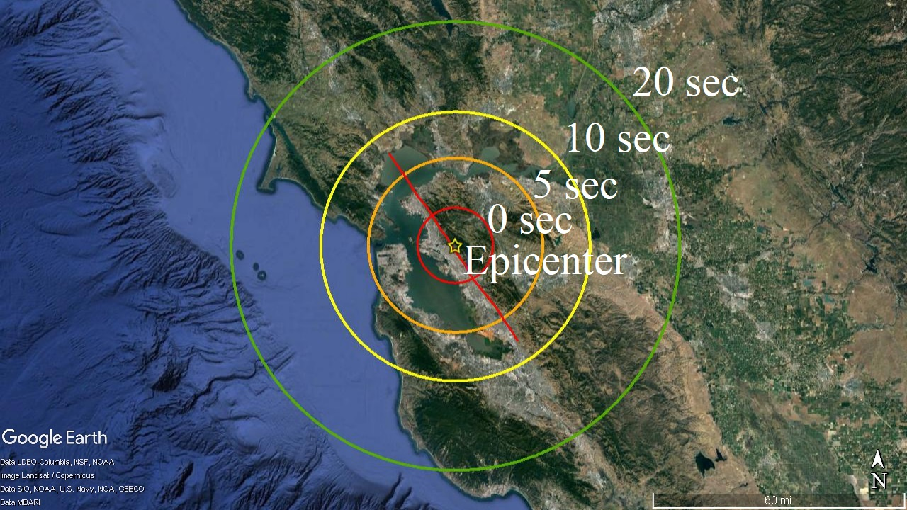
ShakeAlert & Drop, Cover, Hold on
Notes:
A Wired solution to delayed and insufficient alerting will be earthquake early warning called ShakeAlert.
When we feel earthquake shaking, it can take a while to realize what it is. We have precious seconds of time until we would feel the strongest shaking.
Throughout the Bay Area, objects would be shifting and could fall on us. In the most intense shaking areas it would be difficult or impossible to walk and stand up.
ShakeAlert could give us a few seconds of warning in San Francisco and 10 seconds of warning in San Jose. If we use ShakeAlert to prompt us to “drop cover and hold on” there could be 1500 (out of 18,000) less people injured, with an estimated value of 300 million dollars.
HayWired teaches us about interconnectedness: as a source of vulnerabilities, as well as solutions.

Slide 28
HayWired Scenario - Insights
Dr. Keith Porter
Buildings – Communities can't bounce back from disaster if their buildings don't. The building code calls for buildings that you can safely leave after a big earthquake, but they don't assure us that all buildings will be safe to go back into.
Fires – Big earthquakes can burn cities as much as they shake them. Communities can reduce fire risk by acquiring portable water supply systems like those of San Francisco, Berkeley and two other Bay Area fire departments.
Water – The HayWired Scenario could disrupt water service for weeks or months, making fire risk worse, costing billions of dollars in economic disruption, and possibly driving people away from their homes and businesses.
Trapped and Injured Occupants – Adding emergency power to elevators could prevent thousands of people from being trapped.
Notes:
Dr. Keith Porter is a licensed professional engineer and a research professor in Civil, Environmental & Architectural Engineering at the University of Colorado Boulder. He led the engineering section of all four SAFRR scenarios.
[ 0:13 ]

Slide 29

HayWired Illustrates Problems with the
Building Code, Fire, Water, and Elevators
Keith Porter, PE PhD, University of Colorado Boulder

Slide 30
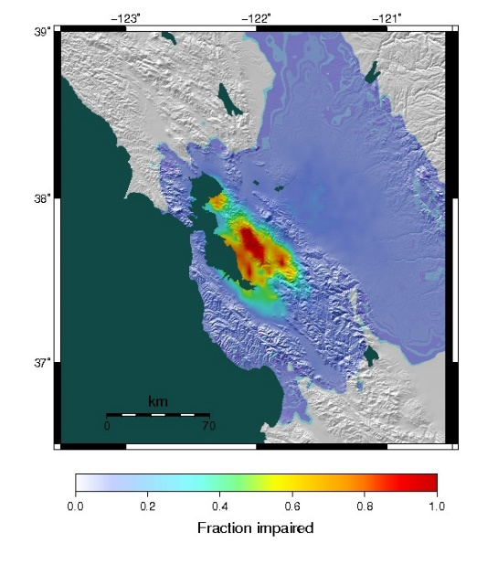
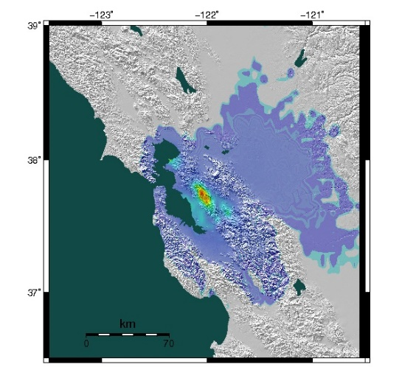
New buildings are safe but not very resilient
Current code: 25% of new buildings collapse or are red- or yellow-tagged
50% stronger: 6% collapse or are red- or yellow-tagged, for 1-3% more building cost
Fraction collapsed, red- or yellow-tagged

Slide 31


Big earthquakes burn cities as much as shake them
HayWired: 670 fires burn equivalent of 53,000 houses, aggravated by water supply damage
Portable water supply systems can improve firefighting water supply
-- Charles Scawthorn, SPA Risk LLC

Slide 32


Pipe damage disrupts water supply, hinders firefighting
Some lack water for months
A resilient grid of ductile pipe can speed recovery

Slide 33

Loss of power traps 22,000 people in elevators
4,500 occupied elevators without power
Power out in some places for days or weeks
Adding emergency power to newer elevators can reduce trapped occupants by 8,000

Slide 34
HayWired illustrates problems with the building code, fire, water, and elevators, causing major problems for society.
We can do better for modest investment in many cases.

Slide 35
HayWired Scenario - Insights
Dr. Laurie Johnson
Damage Footprint and Dollars – We cannot build resilience in an ad hoc, one city-, one project-at-a-time way; we have to approach resiliency in a systematic and comprehensive fashion with a focus on regional housing and infrastructure.
Recovering – Long-term recovery challenges for communities and residents after a catastrophic earthquake like the HayWired Scenario would be unprecedented but not insurmountable if we take collective action now.
Community Resilience - Let’s keep collaborating to strengthen our communities, using science to better understand urban infrastructure, social, and economic linkages.
Notes:
Dr. Laurie Johnson is an urban planner specializing in disaster recovery and catastrophe risk management. She has been involved with all four SAFRR scenarios and is the lead author of the long-term housing and community recovery analysis in HayWired. [ 0:15 ]

Slide 36




High Impact Communities-at-Risk
Percentage of all building square footage in a census tract in an extensive or complete damage state
>60%
20% - 60%
10% - 20%
2% - 10%
<2%

Slide 37


Residents evacuating
San Francisco in 1906 and New Orleans in 2005
Source: U.S. National Archives and Records Administration, and M. Reiger, Federal Emergency Management Agency
Figure: Evacuees at New Orleans airport after Hurricane Katrina’s landfall, September 1, 2005. Source: Michael Reiger, FEMA

Slide 38
Unprecedented but not Insurmountable
Long-Term Recovery Challenges
If we take collective action now to:
Emphasize financial recovery and population displacement in government, individual and business disaster planning, exercises, preparedness campaigns and training.
Plan for long-term recovery at all levels of government, and
Direct more investment and focus in local and regional land use plans on upgrading the seismic resilience of existing communities while future, more resilient, communities are being planned and built.

Slide 39

72% Probability of a
M 6.7 or Greater Earthquake in the Region
For every earthquake, specific patterns of damage and population affected will differ.
Yet, the fundamental vulnerabilities in the region’s building stock, infrastructure and people persist.
Let’s keep collaborating to strengthen our communities

Slide 40
Notes:
With that, the “HayWired Scenario – Insights” portion of the program has concluded.
There will be an opportunity later at the annual Lawson Lecture, 4:45-6:30 p.m., to come back and see these same presentations plus more, and including an opportunity for panel discussion and questions & answers from the audience. We encourage all participants here to stay for that.
Now we will begin the next portion of the press conference.
Dale, back to you. [ 0:32 ]

