Slide 2
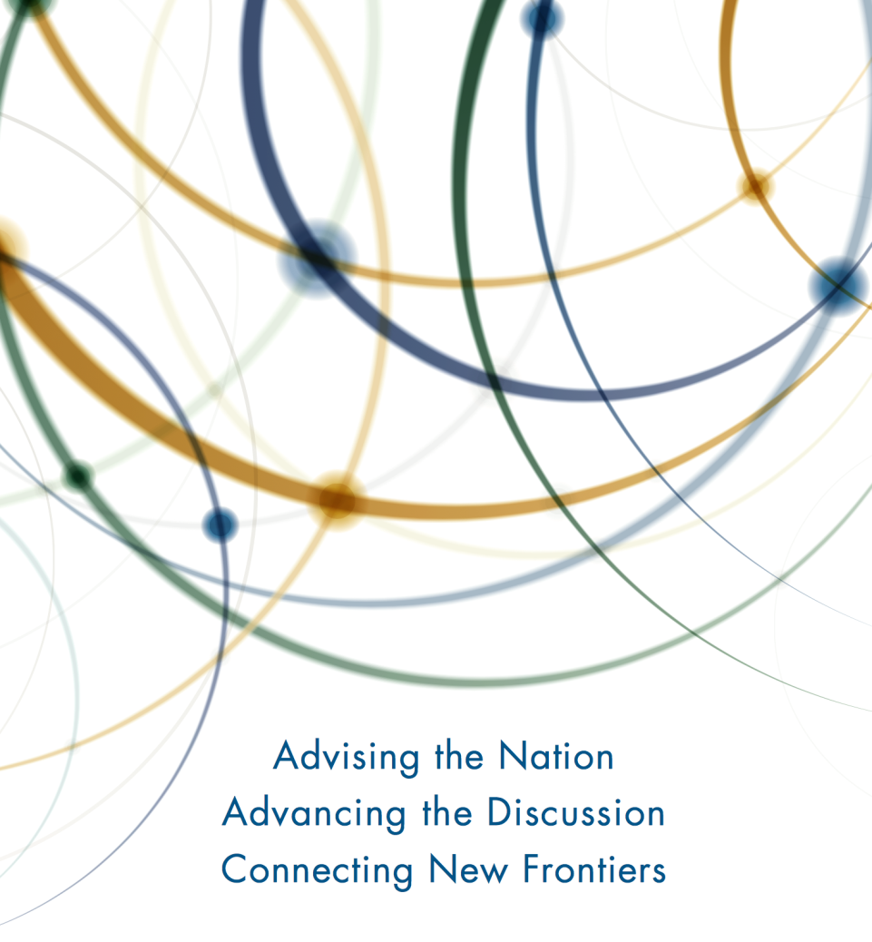
The National Academy of Sciences, National Academy of Engineering, and National Academy of Medicine work together as the National Academies of Sciences, Engineering, and Medicine to provide independent, objective analysis and advice to the nation and conduct other activities to solve complex problems and inform public policy decisions.
For more information about the Academies, please visit http://nationalacademies.org/

Slide 3
Committee
RAMESH RAO, University of California San Diego, Chair
JAMES CAVERLEE, Texas A&M University
ROOP DAVE, Information Technology Research Academy, New Delhi
EVE GRUNTFEST, California Polytechnic State University
BROOKE LIU, University of Maryland
LESLIE LUKE, Los Angeles County Office of Emergency Management
DENNIS MILETI, University of Colorado, Boulder
NAMBIRAJAN SESHADRI, Broadcom Corporation (retired)
DOUGLAS SICKER, Carnegie Mellon University
KATE STARBIRD, University of Washington
CHARLES L. WERNER, ParadeRest and Commonwealth of Virginia
Notes:
Mix of academic and industry experts in relevant technologies and the social sciences as well as experiences emergency managers.

Slide 4
Statement of Task
Review current knowledge about how to effectively deploy and use emergency alert and warning systems and explore related future computing, engineering, and social science research needs
Convene workshop to capture results of DHS S&T-sponsored and other recent research and foster dialog among technologists, social science researchers, and emergency managers
Summarize results of DHS-sponsored research
Provide an overview of current knowledge about emergency alerts and warnings and their relationship to citizen interactions and information needs
Set forth an interdisciplinary research agenda that highlights gaps and future needs

Slide 5
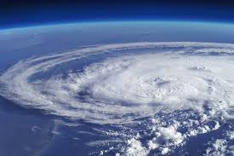
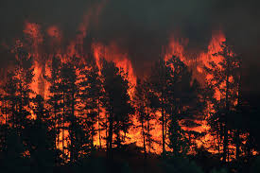
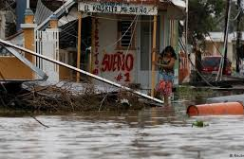
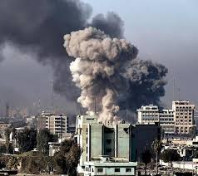
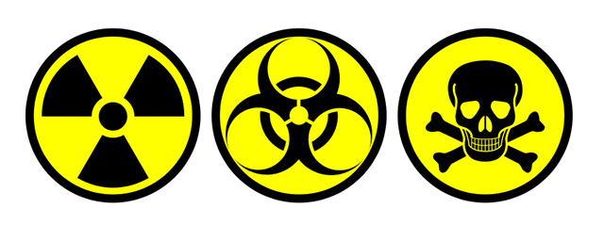
Defining Alerts and Warnings
Purpose of alerts
To deliver messages to warn populations at risk of imminent threats with the goal of maximizing the probability that people take protective actions and minimizing their delay in taking those actions
Why are they important?
To alert the public about natural hazards such as severe weather and manmade events such as terrorist attacks or chem/bio threats

Slide 6
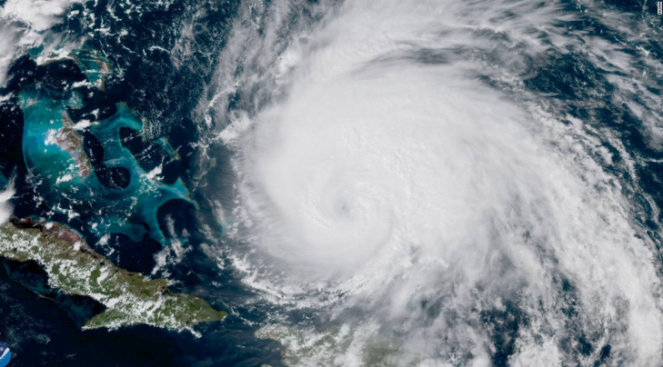
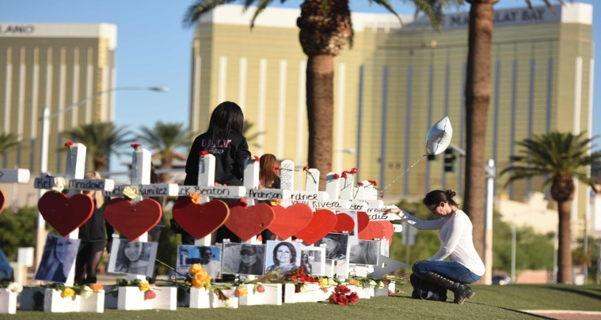
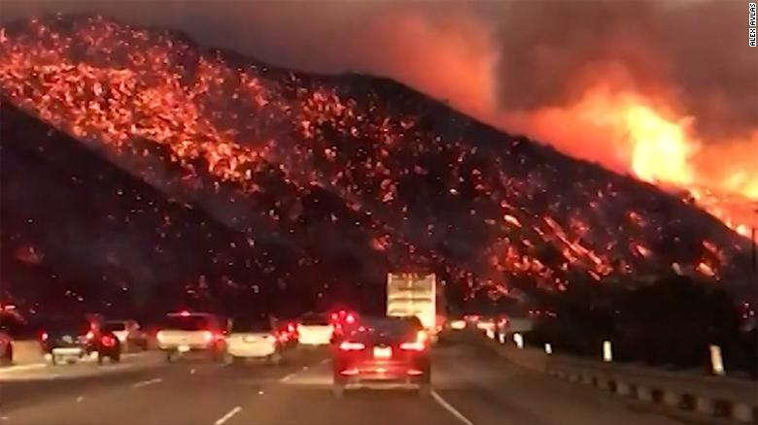
Recent Events
Hurricanes Harvey, Irma, and Maria
The October 1, 2017, shootings on the Las Vegas Strip
2017 California wildfires

Slide 7
Recent DHS-Supported Research
Public Response
E.g., public perception of various hazards, public reactions to messages of various character lengths (140, 280, 1380) and psychophysiological, emotional, cognitive, and behavioral responses to a simulated WEA message
Geotargeting
E.g., new geotargeting mechanisms, diffusion behavior of messages, and public benefit and performance tradeoffs of geo-targeted WEA messages.
Technologies
E.g., integration strategies to aid alert originators adopt and utilize WEA and cybersecurity guidelines for cell carriers

Slide 8
Desired Properties of an Alert System
Only reach people at risk from (or have other interests in) the hazard.
Communicate impact and recommend protective actions that people can understand and can reasonably take, with guidance tailored to the circumstances of each alert recipient.
Reflect changing information needs as an event unfolds
Be respected and trusted by the public, emergency mangers, other public officials, and the media.
Be suitable for all hazards and effective in reaching all at-risk populations.
Work well alongside other government and private information sources.
Allow for collecting feedback from the alerted population to determine the effectiveness of an alert and give emergency managers better situational awareness during an event.

Slide 9
Evolving the Nation’s Alert and Warning System
Goal: Take advantage of new technologies and reflect new knowledge gleaned from events and research
Near-term goals
Increase adoption of WEA and other existing alert and warning systems
Exploit current knowledge about public response to craft more effective alert messages
Use location information currently available on cell phones to improve geotargeting precision
Exploit other comms: 4G/LTE, WiFi, Bluetooth, …
Add capabilities for performance monitoring and user feedback

Slide 10
Evolving the Nation’s Alert and Warning System (cont’d)
Long-term goals
Assure end-to-end service availability and message validity and integrity.
Provide users with more granular control of when and how they’re alerted.
Consider further opening IPAWS data feeds for third-party apps.
Better inform emergency managers by rapidly analyzing social media data.
Use IoT to detect and analyze events and send alerts.
Leverage backup comms such mesh networking and FM broadcast.

Slide 11
Socio-Technical Research Agenda
Knowledge needed to fully realize near-term and long-term goals
Public Response
More effective messages
Better meeting needs of subpopulations
More precise geotargeting
Better education and enhanced community engagement
Post-Alert Feedback and Monitoring
Technical Challenges
More robust/reliable message delivery
Leveraging wider range of connected devices
Protecting security and privacy and increasing trust

Slide 12
Crafting More Efficient Messages
Including protective guidance in links to enhanced media
What information is best included in a message and what information is best included in linked content?
Determine optimal lead times for issuing alerts
What is the best lead time to ensure appropriate action is taken?
Opt-in versus Opt-out
Past research suggests that alerts and warnings should be sent through as many channels as possible, but over alerting is a known problem. What drives opt-in and opt-out behaviors?
Message length
How can longer (360 characters) WEA best be used? What are the optimal message lengths for different hazards and different delivery mechanisms?

Slide 13
Meeting the Needs of Subpopulations
Language and dialects
In what cases will templates and machine translation be “good enough”?
Differing abilities
How can messages be best presented to physically and cognitively challenged individuals?
“Digital divide”
How do we take advantage of new technologies while also ensuring those with less access receive timely alerts?

Slide 14
Geotargeting
Determining locations of interest
How can locations of interest (other than current location) be dynamically updated rather than manually specified by users?
Location-based protective action
What are the opportunities for more precisely specifying protective action based on location? How can such capabilities be realized?
In-building location
Such information can be used to determine evacuation routes to advise on evacuation versus sheltering in place. For example, it is currently hard to determine on what floor a user is located.
Communicating location
How to best communicate, possibly through visualizations, about the location of the message recipient versus the area of impact?

Slide 15
Community Engagement & Education
How can emergency managers make effective use of community-oriented tools such as NextDoor?
How can we leverage social media to enhance community engagement and promote disaster education?
What methods are effective in motivating behavior change?
What other factors contribute to successful public disaster education campaigns? How important is in-person training? What role can new techniques such as gamification play?
Notes:
Across the DHS-funded studies, research participants were found to be unfamiliar with WEA, and currently, public education campaigns are typically ineffective because they are not specific enough and do not contain content that motivates behavior change. In the future, studies may want to focus on what motivates behavior change and what other factors contribute to successful public disaster education campaigns. Do in-person trainings or gamification, for example, have an impact?

Slide 16
Post-Alert Feedback
What information would be most helpful to emergency mangers before, during, and after an event?
What information would be helpful to hazards researchers?
What is the best way to collect the information, taking into account technical constraints and privacy concerns?
Notes:
Gathering feedback from message recipients to help understand how the public is responding to messages might be needed. Feedback could help validate laboratory experiments and aid in the crafting of better messages.
Enhanced tools are also needed for analyzing and presenting feedback and social media data to provide emergency managers with better situational awareness. This can include a model like Waze, in which users can update and verify things such as road closures, flooding, or other hazards.

Slide 17
WEA Delivery Technology
What would the impact of including a URL be on network capacity?
What is causing failures to deliver WEA messages as evidenced by recent testing?
Can we move beyond 90 characters and take advantage of the longer message lengths offered by 3/4/5G networks while providing backward compatibility?
Is it feasible to combine multiple cell broadcast messages into a single, longer alert message?
How to complement WEA with other modalities including third-party apps and services to reach more recipients and increase the likelihood of delivery?

Slide 18
Enhancing Alert Delivery
Bypassing network failure
Can we exploit alternative ways to deliver information to phones such as mesh networks, peer-to-peer communication, and FM radio?
Can we use peer-to-peer communications techniques, such as those used by FireChat, to relay messages to people without a direct network connection?
How do we validate the efficacy of these technologies?
Battery life management
How do we reserve power on cell phones and other devices so alerts can continue to be received during an event?
Can we provide feedback to alert originators on whether future messages will be delivered given current device battery levels in the target audience?

Slide 19
Role of Connected Devices
Automated alerts based on aggregated data
Faster event detection and alerting for very fast moving hazards such as active shooters
Need to aggregate enough data so that machine learning can be used in a robust fashion to reliably detect events and gain sufficient situational awareness to determine the best protective action
Best devices for alerting
Which devices should be used to issue alerts for which hazards?
Are there opportunities to customize where alerts are sent to better communicate appropriate protective action? For example, under a boil water order, could an alert be presented on a smart refrigerator when the water dispenser is used?
Reducing milling with virtual assistants
What role can devices such as Alexa or Google Home play in answering questions to reduce milling behavior or to provide info about protective actions?

Slide 20
Trust, Security, and Privacy
How can we issue the necessary credentials to state and local emergency managers nationwide and provide necessary training?
For example, could we simplify by issuing jurisdiction-wide rather than individual credentials?
How can emergency managers quickly detect and effectively respond to the spread of false or misleading information?
How can personal information be used to provide geographically relevant information while protecting individual privacy?
Notes:
A system that instructs large populations to take a particular action may represent a significant target for attacks on service availability, compromises of the integrity of valid messages, and spoofed messages.
Examples: In 2013, the Associated Press twitter account was used to post false reports about explosion at the White House; in 2016 a hacker sent out an emergency alert that read “dead bodies are rising from their graves,” in some counties in Great Falls, Montana; in 2017, a hacker set off all 156 emergency sirens in Dallas, Texas.
Actual or perceived privacy risks that impede the use of valuable new capabilities.

Slide 21
Challenges to Building a Better Alerting System
Slow adoption of new systems by alert originators
Limitations of weather forecasts and other information about hazards
Ever-changing technology
Difficulty of interdisciplinary research and translating research results to practice
Incentivizing relevant stakeholders to participate
Notes:
Slow adoption of new systems by alert originators.
Limitations on weather forecasts and other information about hazards. Effective alerting depends on modeling and data collection and analysis capabilities being maintained and advanced.
Ever-changing technology. To reach the majority of individuals, systems must not only evolve but continue to make use of legacy technologies. Furthermore, both the technology of emergency alerts and citizens’ capacity to comprehend the alerts and use messaging functions also continue to evolve. The interaction between the developing technologies and citizens’ capacity to use these technologies effectively on a community scale is itself an issue for future research.
Difficulty of interdisciplinary research and converting research to practice.
Incentives to participate: How do we encourage openness among stakeholders and encourage participation by those who operate other valuable computer and communications capabilities?

Slide 22
Summary
A more cohesive and all-encompassing alert and warning system is needed that can:
Better integrate public and private communications mechanisms and sources of information
Continue to provide the necessary information for the purpose of preserving the health and safety of people
Employ a technology-agnostic architecture that allows new technologies for delivering alerts be adopted quickly.
The nation’s alerting capabilities, such as WEA and IPAWS, will need to evolve and progress as the capabilities of smart phones and other mobile broadband devices improve and newer technologies become available.
This evolution will need to be informed by both technical and social and behavioral science research.

Slide 23
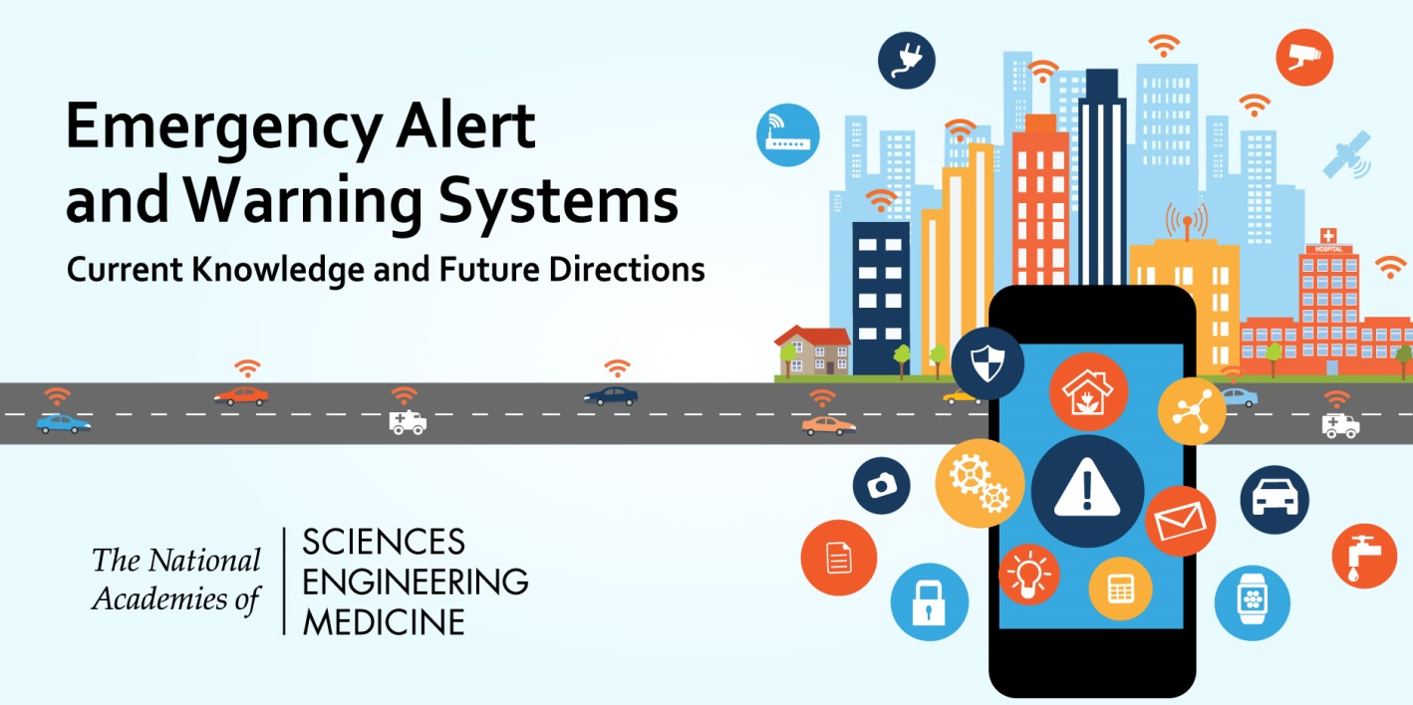
Questions?
Download the report at nap.edu/24935

